Slide 1

Best Design Practices for Systems with PDN Noise-Sensitive Circuits
Steve Sandler - Picotest

Slide 2


Presenter Bio
Steve Sandler has been involved with power system engineering for nearly 40 years. Steve is the founder of PICOTEST.com, a company specializing in instruments and accessories for high performance power system and distributed system testing. He frequently lectures and leads workshops internationally on the topics of Power Integrity, and Distributed Power System Design and is a Keysight Certified EDA expert.
Steve publishes articles and books related to power supply and power distribution network (‘PDN’) performance. His latest book, “Power Integrity: Measuring, Optimizing and Troubleshooting Power-Related Parameters in Electronics Systems” was published by McGrawHill in 2014. He is the recipient of both DesignCon 2017 and EDICON 2017 Best Paper Awards.
Notes:
Hi, I’m Steve Sandler and in today’s webinar I’m going to talk about designing power supplies for sensitive circuits. More specifically, I’m going to talk about two topics:
How to determine the sensitivity of the circuit
If it is sensitive, how do I design the power supply so as not to degrade the circuit performance.
I’ll use an off the shelf surface mount crystal clock oscillator to demonstrate the techniques I am sharing in this webinar.

Slide 3

Sponsored by
Rohde & Schwarz
Largest manufacturer of electronic T&M equipment in Europe
World market leader for Electro Magnetic Compatibility (EMC) testing
Key partner for wireless communication manufacturers & network operators
80 years of RF T&M experience and expertise
Technology leader for radio communication test sets
More at www.rohde-schwarz.com

Slide 4
What You’ll Gain From This Webinar
In this webinar we’ll answer these important questions, provide the essential information you need
and allay your fears:
Are these types of circuits all sensitive?
How do I know how sensitive the circuit is?
How do I fit between over-design and under-design?
What about the special RF linear regulators?
Notes:
I know most of you are very busy with many tasks on your list and this is just one of them. After watching this webinar you’ll know how to determine if your circuit is sensitive and if so, how to create an optimized power supply solution. If your circuit board is already built and underperforming, you’ll also learn how to optimally correct it. By optimally, I mean the quickest path to the most cost effective solution.

Slide 5
What are sensitive circuits
Many low power circuits are hyper-sensitive to power supply noise.
Examples of hyper-sensitive circuits include clock oscillators (XOs), low noise amplifiers (LNAs), phase locked loops (PLLs), mixers, audio codecs, ADC’s, DAC’s and precision voltage references to name just a few.
In the context of this webinar, we’re only concerned with the sensitivity to power supply noise. While the circuit may be sensitive to other things, we are interested in how the power supply noise contributes.
Notes:
What I am referring to as sensitive circuits are generally low power circuits that are dependent on very low noise outputs. From the emails I receive asking for advice, common sensitive circuits include, in no particular order, reference oscillators, LNA’s, audio codec’s, phase locked loops, sensors, ADC’s, and DAC’s. While this probably isn’t complete list, these are the devices I receive the most emails about. On the other hand, just because a circuit is on this list as sensitive, doesn’t mean that ALL these devices will be sensitive. That’s the first thing we need to determine.

Slide 6
Sensitivity to power supply noise
All semiconductor circuits have some degree of nonlinearity.
Here a diode represents the nonlinearity
Two signals appear at the semiconductor junction.
A 100MHz DC offset carrier and a lower frequency signal representing power supply noise
Notes:
All semiconductor circuits have some degree of nonlinearity. Here a diode represents the nonlinearity Two signals appear at the semiconductor junction. A 100MHz DC offset carrier and a lower frequency signal representing power supply noise

Slide 7
Carrier alone
Carrier and Small Modulation
Carrier and Large Modulation
PSMR for Power Supply Modulation Ratio
Notes:
When a noise signal is presented to a non-linear circuit, individual frequencies are multiplied, resulting in mixing products. For example, the simple circuit shown in Figure 1 contains a 100 MHz signal with DC offset to bias a silicon diode. A second, 500kHz, signal is also applied to the diode. The diode is a nonlinear element with the voltage being related to the log of the diode current. The sum of two log signals is related to the product of the two signals, causing the mixing products.

Slide 8
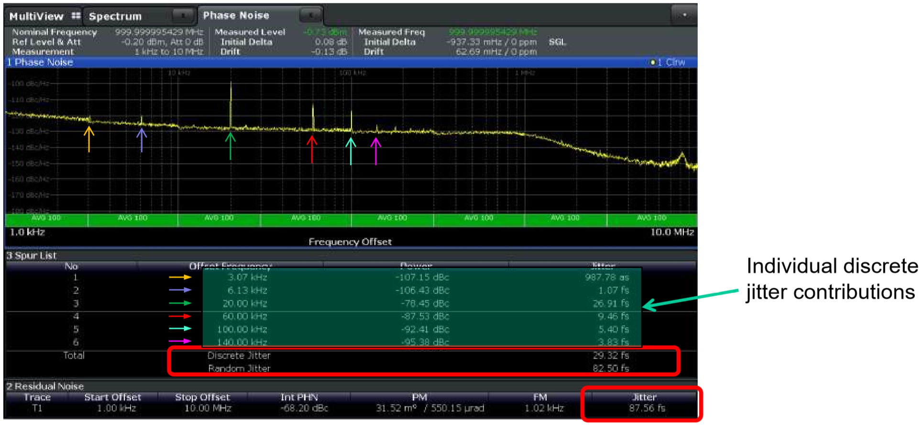
Spurs (Discrete) vs Broadband (Random) Noise
Most of the jitter is generally due to random noise. Spurs or individual discrete signals, such as switching power supply ripple do contribute to jitter, but impact spurious free dynamic response in a bigger way.
random
discrete
Power supplies contribute both random and discrete jitter
Image courtesy Rohde & Schwarz
Notes:
Injecting a single modulation tone like this results in spurs, which impact spurious free dynamic response, but since spurs have narrow bandwidth they don’t generally contribute much to integrated jitter. Broadband noise also mixes with the carrier signal but raises the device noise floor and that does significantly impact jitter.

Slide 9
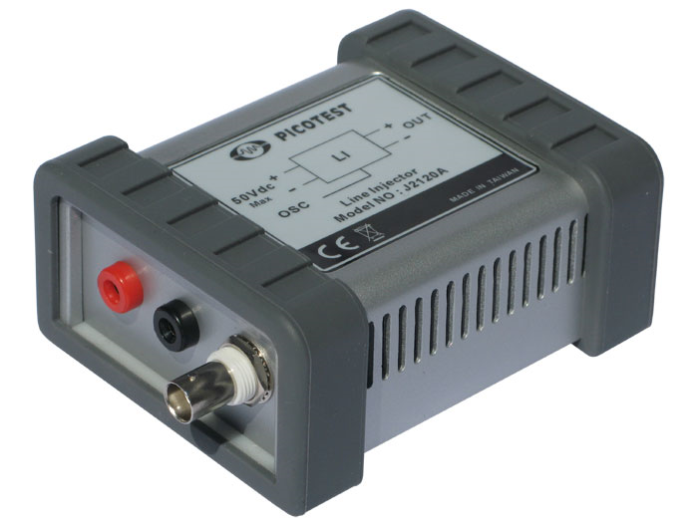
Getting close to a noiseless power supply
Filter and Damping
Ripple Stripper
High Current Buffer
DC in
DC+OSC out
Summer
OSC
Bias network
There are some special voltage regulators that offer very low noise and we’ll discuss those later in this webinar.
In addition to being ultra-low noise the line injector allows noise to be superimposed on the power supply
Notes:
We really want to establish a baseline using a noiseless power supply to get just the device noise without any power supply contribution. Of course there’s no such thing as a noiseless power supply, but it’s important to get as noise free as possible. Several semiconductor companies offer ultra-low noise voltage regulators and we’ll talk about them later in this webinar. I performed the noise free measurements for this webinar using a J2120A Line Injector, which is inserted between a lab power supply and the sensitive circuit. This is a passive device that includes an effective noise stripper, resulting in ultra-low output noise. The output noise is similar in magnitude to the ultra-low noise voltage regulators, but the line injector also includes a modulation input. The modulation input is used to superimposes an external noise signal onto the DC power supply voltage.

Slide 10
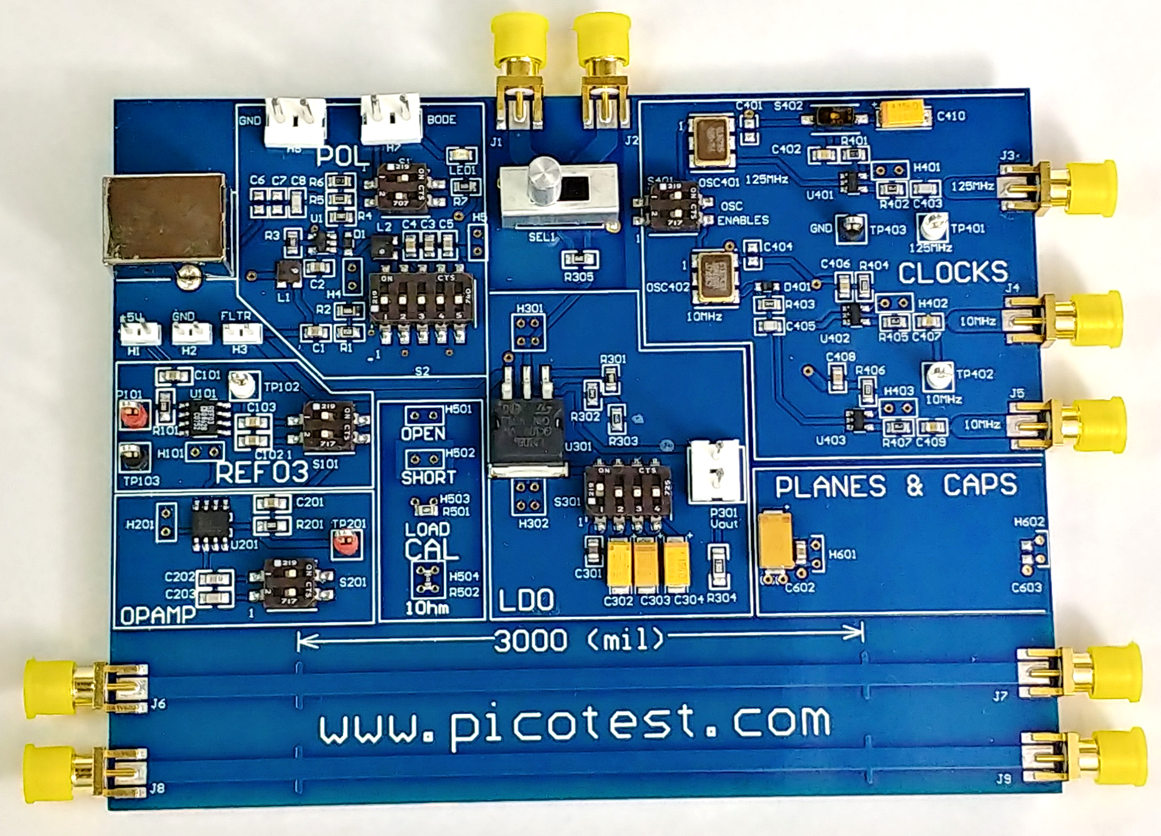
The Example I’ll use
3.3V Plane
Two selectable power supplies are included on this demo board. One is a linear regulator and the other is a switching regulator. Either power supply can be connected to a 125MHz SMD oscillator
A pair of SMA connectors connected to the power plane.
A “noiseless” power supply can be provided through an SMA connectors and the power supply noise can also be monitored through an SMA connectors
selector
Linear reg
enable
Notes:
In addition to the noise free power supply and modulator I also used a demonstration board that includes a switching regulator with an enable and a linear regulator. A selector switch connects either regulator to the 3.3V power plane. A pair of SMA connectors are also connected to this 3.3V plane and I’ll use these SMA connectors to connect the line injector. This provides three options for powering the 3.3V power plane – the noise free J2120A a 2.8MHz switching regulator and a low dropout linear regulator. The 3.3V power rail powers a 125MHz clock and clock buffer, and we’ll use that clock as our sensitive circuit example. The switching power supply has an enable switch and so I disabled it for the linear regulator and noise free measurements to keep the switching noise from coupling into the clock.

Slide 11
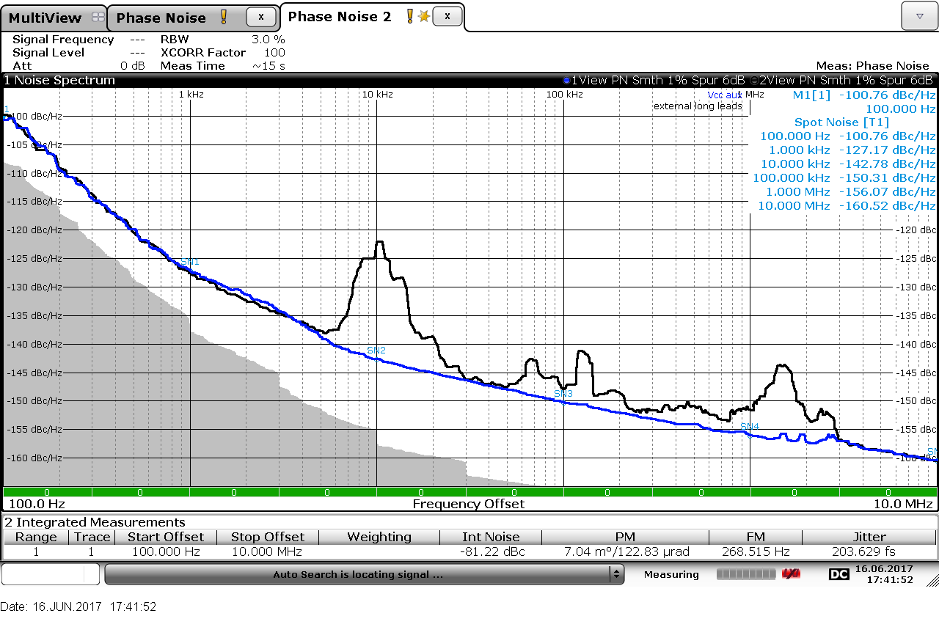
At these noise levels the cables are important
Airborne noise can couple into the cables can become quite significant in the measurement.
I use very short multiple shield coaxial cables or direct adapter connections to connect the line injector to the sensitive circuit.
50 Ω coaxial cable needs to be very short since neither the clock or the line injector are 50 Ω.
This measurement pair shows the phase noise of an ultra-low jitter clock connected to the line injector using a short double-shield coaxial cable and using 18” banana leads.
low jitter clock connected short double-shield coaxial and 18” banana leads
Notes:
Airborne noise can also couple into the power supply, and at these ultra-low noise levels airborne noise can become quite significant in the measurement. I prefer to use very short multiple shield coaxial cable to connect the line injector to the sensitive circuit. The 50 Ω coaxial cable needs to be very short to avoid resonances in the power leads, since neither the clock or the line injector are a good impedance match for the coaxial cable. This measurement pair shows the phase noise of an ultra-low jitter clock connected to the line injector using a short double-shield coaxial cable and using 18” banana leads.

Slide 12
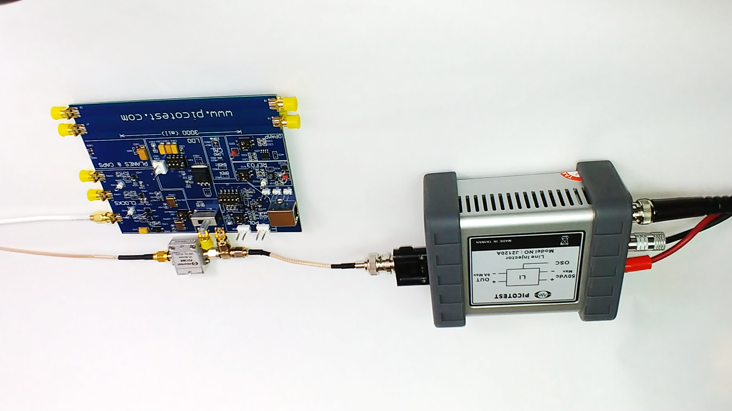
Setup for connection and monitoring
Notes:
All of these considerations led to my measurement setup. You can see I used short, coaxial connections and you can also see that I added a TEE adapter and a DC block so that the injected power supply signal noise could also be monitored.. Depending on the signal level, in some cases the spectrum function on an oscilloscope will also work for monitoring the injected signal amplitude.

Slide 13
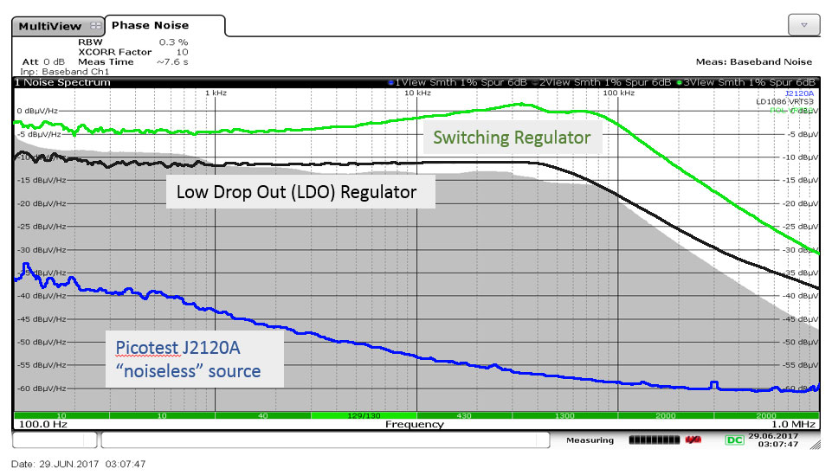
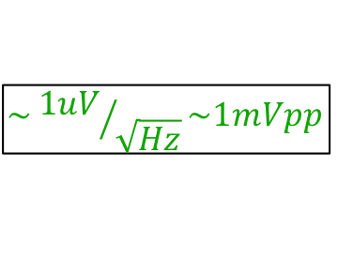
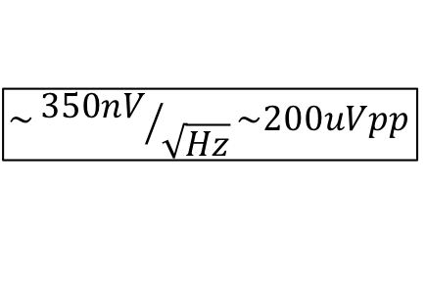
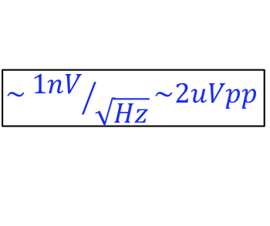
$$\sim {1uV}/{\sqrt{Hz}}\sim 1mVpp$$
$$\sim {350nV}/{\sqrt{Hz}}\sim 200uVpp$$
$$\sim {1nV}/{\sqrt{Hz}}\sim 2uVpp$$
Integrated noise voltage 1kHz to 100kHz
Notes:
Here you can see a comparison of the noise density for the two voltage regulators on the VRTS3 demo board I used for these measurements along with the noise density for the J2120A line injector we’ll refer to as noiseless.

Slide 14
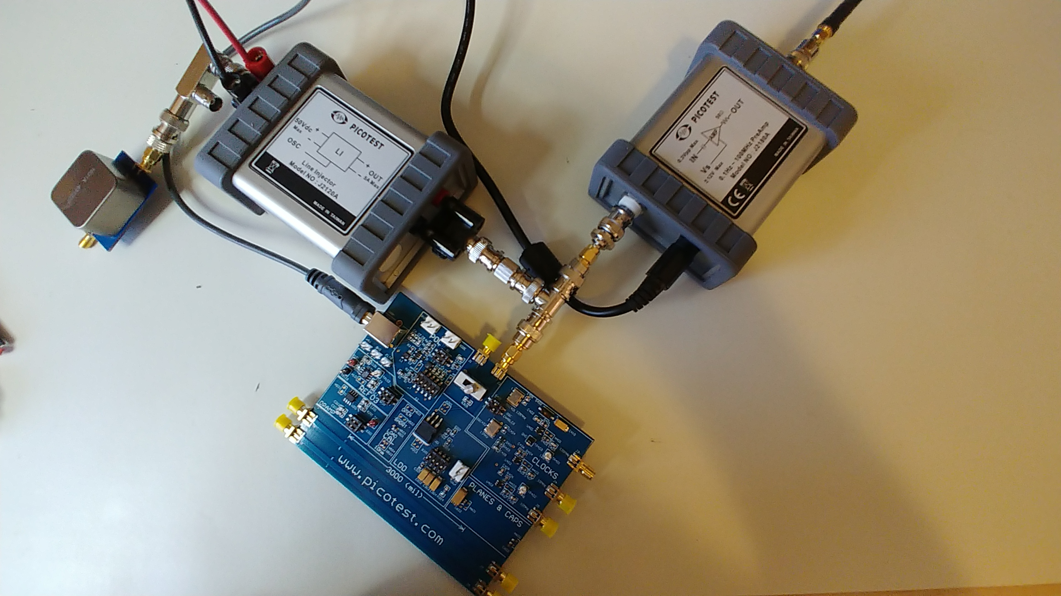
Using an Oscilloscope
It’s sometimes possible to obtain the power supply noise density measurements using the spectrum capabilities of an oscilloscope.
A preamplifier between the power supply and the oscilloscope improves the noise floor.
I added large filter capacitor at the J2120A line injector input to further minimize external noise.
Very short well shielded connections also help minimize external noise
Preamplifier
Evans cap
8800uF
Short connections

Slide 15
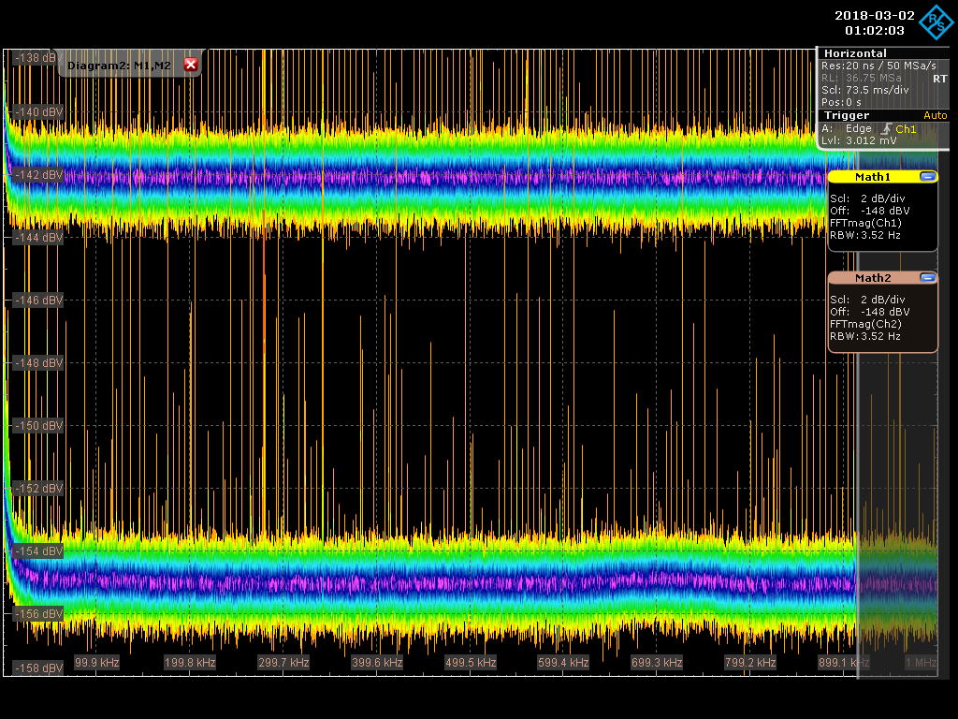
Improving the noise floor
These two noise density measurements show the noise floor of the oscilloscope. The upper trace is one oscilloscope channel set for 50Ohm input and with a 50Ohm terminator connected.
The lower measurement is a 2nd channel of the oscilloscope with a low noise preamplifier inserted. The preamplifier input also has a 50Ohm terminator on it’s input. The probe gain is adjusted to 0.1V/V to account for the gain.
The noise floor is improved by 14dB due to the addition of the preamplifier
Notes:
Here is a comparison of the average measurement noise floor with and without the 20dB low noise preamplifier, The preamplifier reduces the noise level by approximately 14dB and is generally a good idea if you want to use an oscilloscope for the noise density measurement.

Slide 16
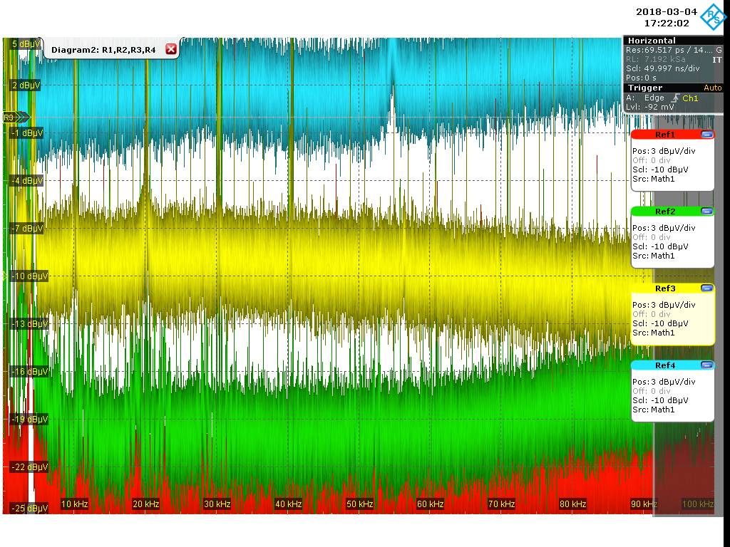
Power Supply Noise with Oscilloscope
Switching regulator -2dBv
-120dBV pk (0dBuV)
Linear regulator -9dBuv
-121dBV peak
Noiseless Power Supply -21dBuV
Noise floor -23duBv
Notes:
Here the oscilloscope shows the noise density of the 3 power supplies as well as the measurement noise floor. While not nearly as high resolution or clean as the phase noise analyzer the measurement still provides usable data. The measurements of the linear regulator and switching requlator are reasonably close to the results from the phase noise meter. The noiseless measurement and noise floor are significantly higher If this is starting to sound complicated, have no fear I promise that I will make this all very simple for you before we are finished.

Slide 17
Signal Measurement Test Setup
Power input
Power output
DC Block to scope/spectrum
Clock to Analyzer
MOD input
Notes:
Now we’re finally ready to make some signal measurements using our noiseless setup. I’m using SMD clocks for this webinar, but the same technique is generally applicable to other sensitive circuits.

Slide 18
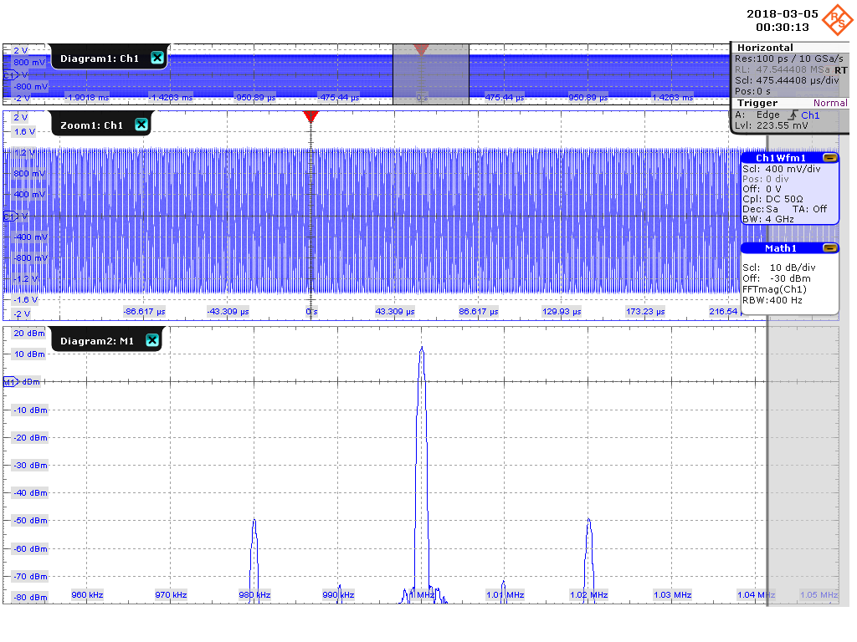
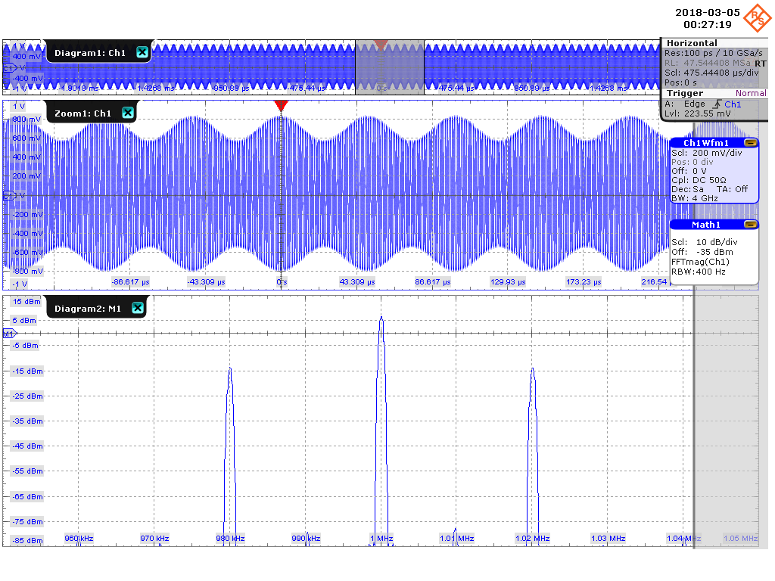
AM & PM Cause Spurs, Jitter is Primarily PM
1MHz with 0.1 deg PM at 20kHz
1MHz with 20% AM at 20kHz
PM Modulation
PM Modulation
Notes:
All modulation schemes result in signal spurs, but they don’t all contribute to jitter in the same way. Most jitter is due to phase noise and so while you might use an oscilloscope to identify the modulation spurs, it isn’t necessarily the best way to determine jitter.

Slide 19
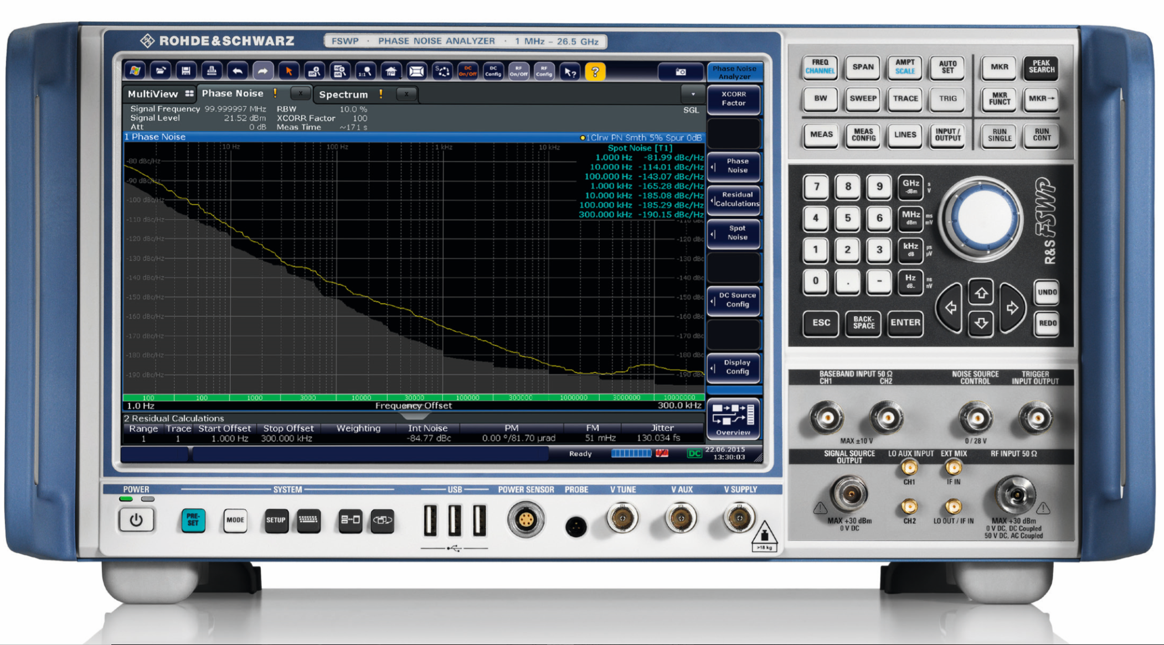
This Often Requires a Phase Noise Analyzer
NOTE: The internal bias supplies may not be sufficiently low noise for sensitive circuits.
The phase noise analyzer offers
Very fast measurements with 1Hz bandwidth.
Can distinguish between AM noise PM noise.
Incredible dynamic Range
Also measures power supply noise density
Much lower noise floor than an oscilloscope
Spur removal provides cleaner results
up to 25dB sensitivity improvement using cross-correlation option
Several companies offer phase noise analyzers. I used the FSWP for this webinar.
Notes:
The ideal instrument for measuring phase noise is a phase noise meter. The phase noise meter has a much lower noise floor than an oscilloscope, greatly improved dynamic range and can separate AM and PM modulation. This instrument simultaneously presents time jitter results. The instrument provides total jitter sa well as the individual discrete (spur) contributors and the random jitter. This is by far the best method of measuring phase noise and jitter.

Slide 20
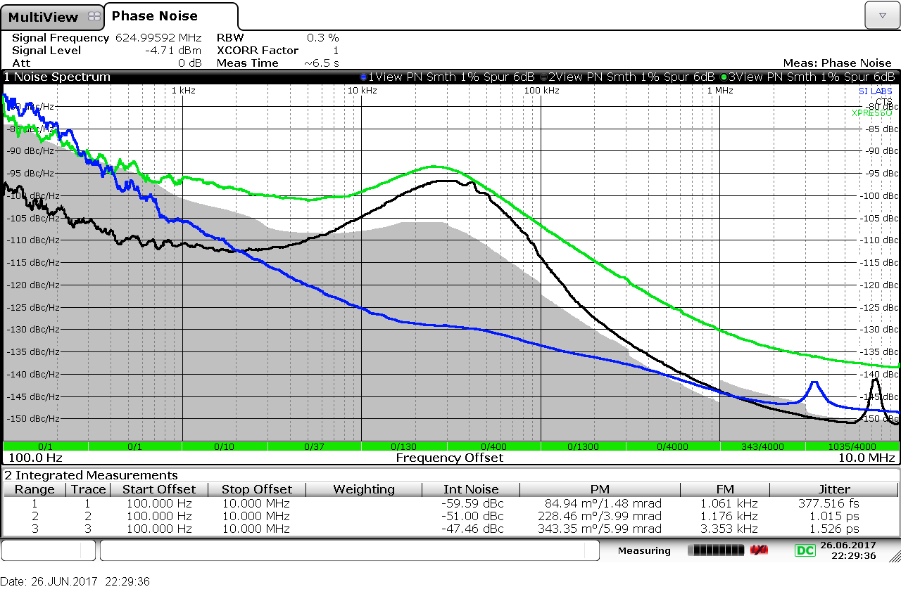
3 Different Clocks with the Noiseless power
The demo board has a 125MHz Xpresso™ clock mounted, and I removed and replaced it with two other clocks for this comparison.
I highly recommend measuring several devices like this before choosing the best one for your application.
If the performance with this noiseless setup isn’t good enough, you’ll need to choose a different device. This is the phase noise floor of the device and It will never be better than this.
Phase noise of three different 125MHz clocks

Slide 21
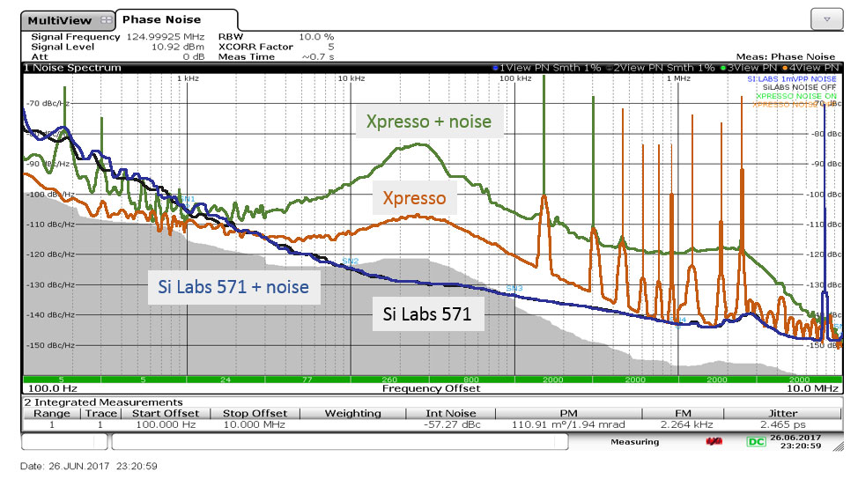
Adding 1mVpp noise via the Line Inector
I measured the phase noise of both clocks powered by the noiseless line injector and saved these measurements as reference traces.
I added 1mVpp of broadband noise through the modulation input of the line injector.
The SiLabs 571 clock shows no sensitivity at all to power supply noise. You can pretty much connect it to any power supply you like without degrading the phase noise or jitter.
The highest and lowest phase noise clocks of the three

Slide 22
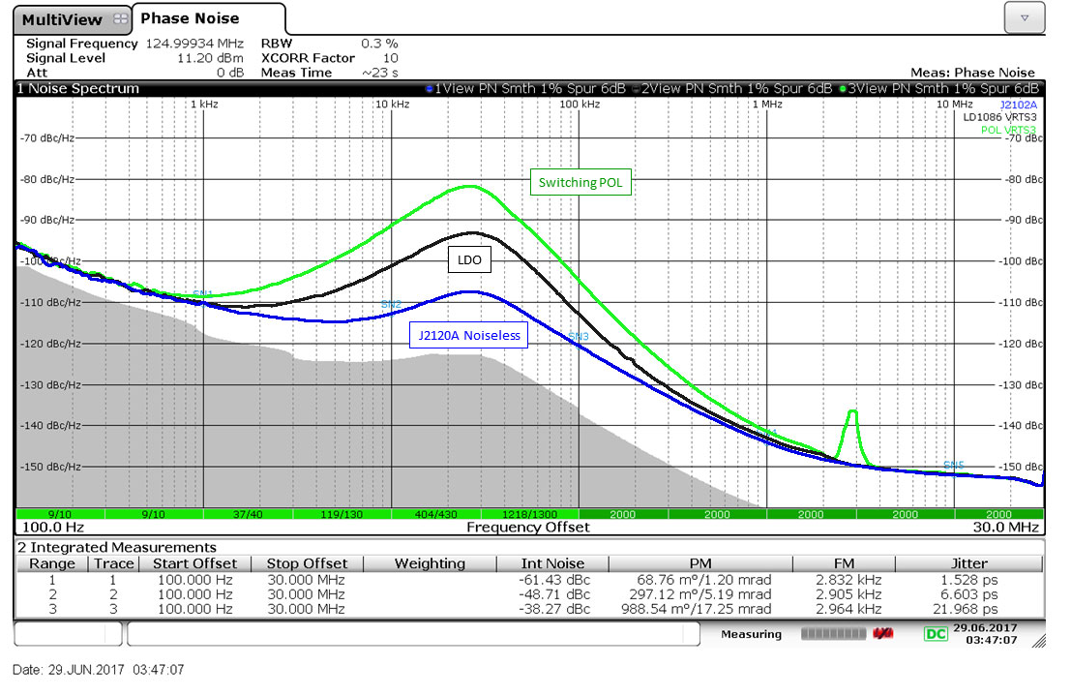
The Same Clock with 3 Power Supplies
The power supply has a significant influence on the phase noise of this clock
The phase noise portrayed as jitter in the lower right corner of the screen.
Jitter is 1.5ps for the noise free line injector, 6.6ps for the linear regulator and 22ps for the switching regulator.
You can also see the phase noise resulting from the 2.8MHz switching frequency of the switching power supply. We’ll talk more about that later.
Demo board clock, using my measurement setup

Slide 23
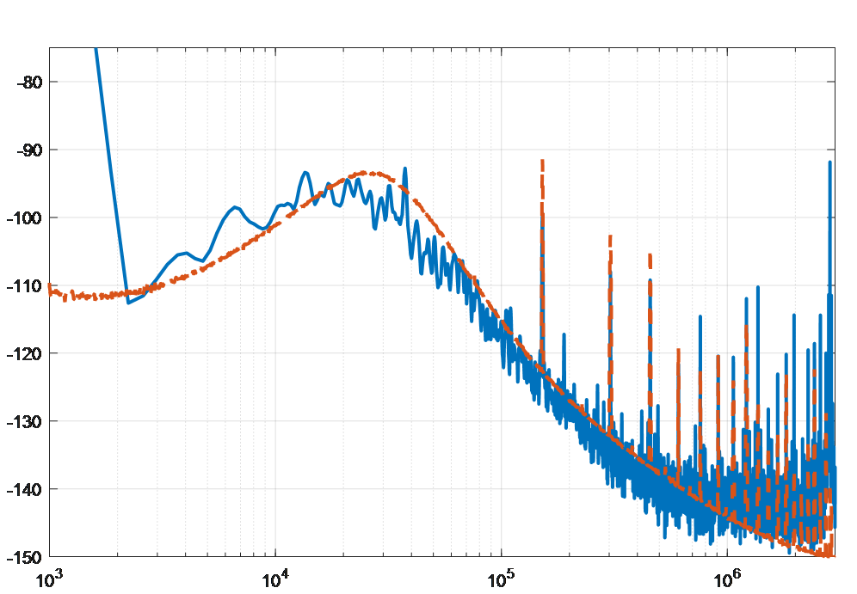
Clock Spectrum
Time interval error (TIE) is a common oscilloscope based jitter measurement
TIE is equivalent to a sampled version of phase noise and so the spectrum of a sequence of TIE measurements is proportional to phase noise.
The blue trace shows the phase noise obtained from the oscilloscope trend spectrum while the red trace shows the phase noise using the FSWP phase noise analyzer.
The measurements agree closely though the phase noise analyzer offers a faster measurement with lower noise floor and cleaner plots
Phase noise from RTO (blue) and FSWP (red)
Notes:
Jitter is commonly measured using an oscilloscope. The measurement is time interval error or TIE. The TIE is equivalent to a sampled version of phase noise and so the spectrum of a sequence of TIE measurements known as a trend or track is, to within a scaling factor, the phase noise.
The plots shown here are the phase noise plots measured using the FFT of the TIE trend on an oscilloscope (blue trace) and the same oscillator measured using an FSWP phase noise analyzer (red trace). The scaling factor to convert the TIE trend is 20log(pi*125e6*FFT(TIE)/sqrt(RBW)). The measurements agree closely with the phase noise analyzer but there are more spurs in the TIE measurement due to the sampled phase error that results in aliasing and the noise floor of the oscilloscope is higher than that of the phase noise analyzer.

Slide 24
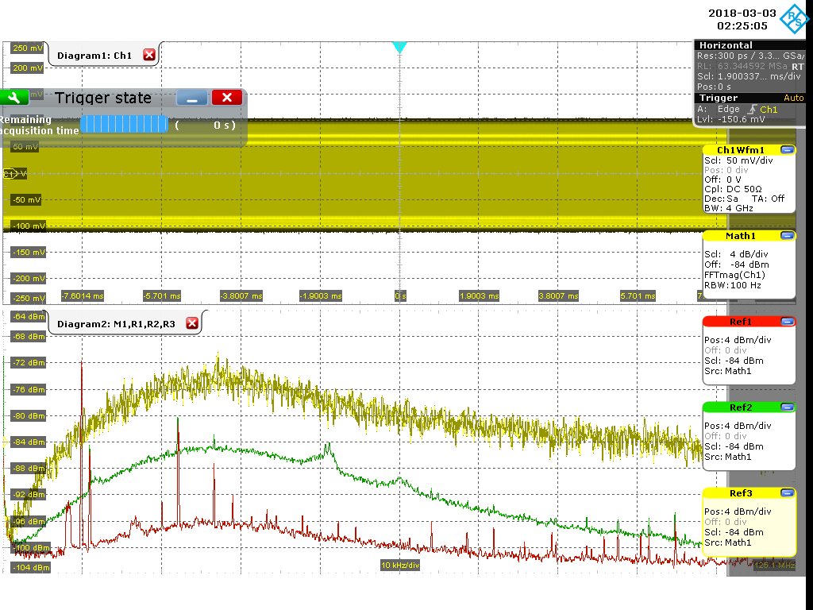
Clock Spectrum
With a good oscilloscope we can also look at the phase noise, though clearly not with the same fidelity, dynamic range or noise floor.
Display is 125MHz- 125.1MHz so the carrier is just at the very left of the display, barely visible.
The three displays are the oscillator spectrum with the noiseless power supply (red) the linear regulator (green) and the switching power supply (yellow)
125MHz clock
25kHz
+22dB
Switching power supply
+12dB
baseline
Linear power supply
Noiseless power supply

Slide 25
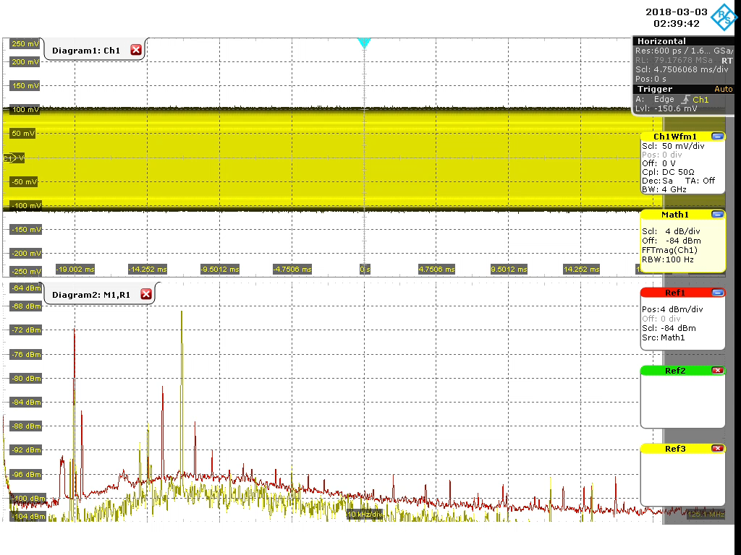
50uVpk Modulation (5mV/40dB atten)
Notes:
There are two methods we can use to achieve the noise free performance of the clock. One method is to connect a signal generator to the line injector modulation input. Then inject a low amplitude sine signal and measure the resulting phase noise spur. Repeat this measurement at many frequencies and use this to generate a PSMR curve of the sensitive device. From this curve, and the allowable degradation, the allowable power supply noise can be determined as a function of frequency. Just reduce the 5uV by the spur height. Then of course you need to design a power supply to that noise requirement.

Slide 26
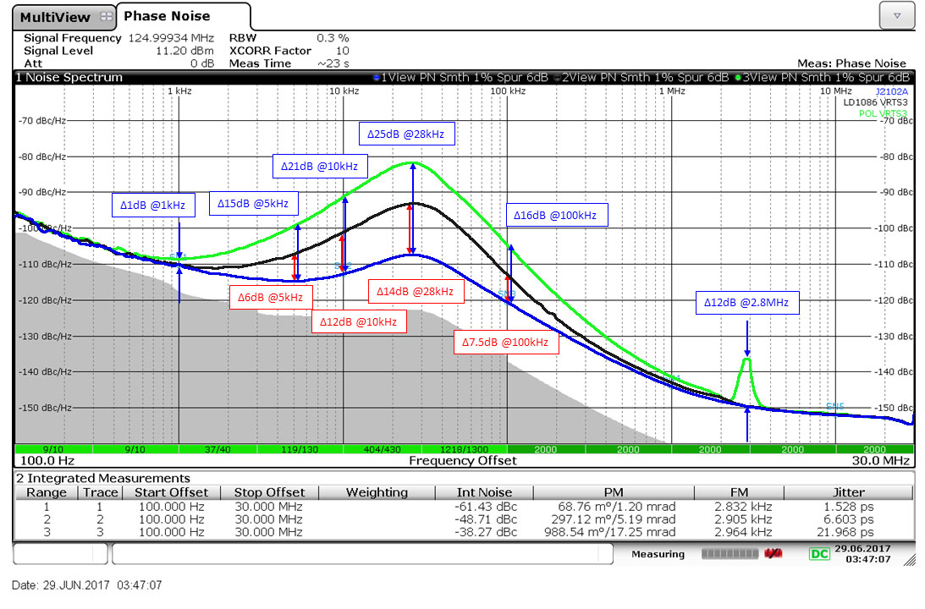
Assessing the Damage
We already have the noise free phase noise plot as well as the phase noise plots for the two power supplies on the board.
We can use the difference between the noise free trace and the power supply traces to determine how much EXCESS noise there is for each power supply.
This EXCESS noise is what we need to remove in order to obtain the noise free performance without overdesign.
Notes:
Since we already have the noise free phase noise plot as well as the phase noise plots for the two power supplies on the board, we can use the difference between the noise free trace and the power supply trace to determine how much EXCESS noise there is for each power supply

Slide 27
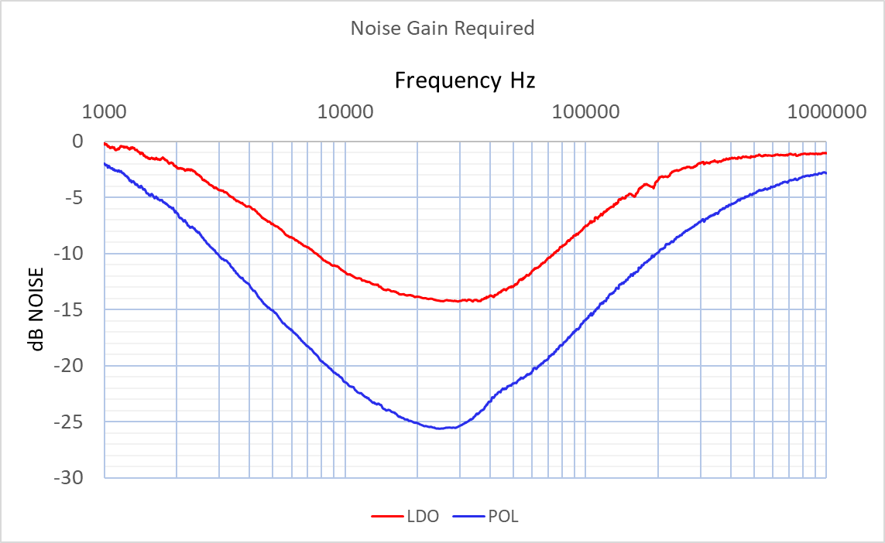
Calculating the difference
dB_{max}=14dB
dB_{max}=25dB
The trace data was exported to EXCEL and the subtractions were performed and graphed.
Just a few frequencies are shown here.
25kHz
Notes:
I’ve subtracted each of the power supply phase noise traces from the noise free. I did this by exporting the trace data to EXCEL. There are 20,000 frequency points in the data, so I only showed a few of them and compressed them so that you could see the DIFFERENCE value is frequency dependent. I also plotted the data for all 20,000 frequency points. This curve represents the attenuation needed to precisely equal the noise free performance. This is our goal, since it will provide the optimum result. Overdesign of the power supply would cost more with no benefit, and under-designing the power supply, so will result in degraded performance.

Slide 28
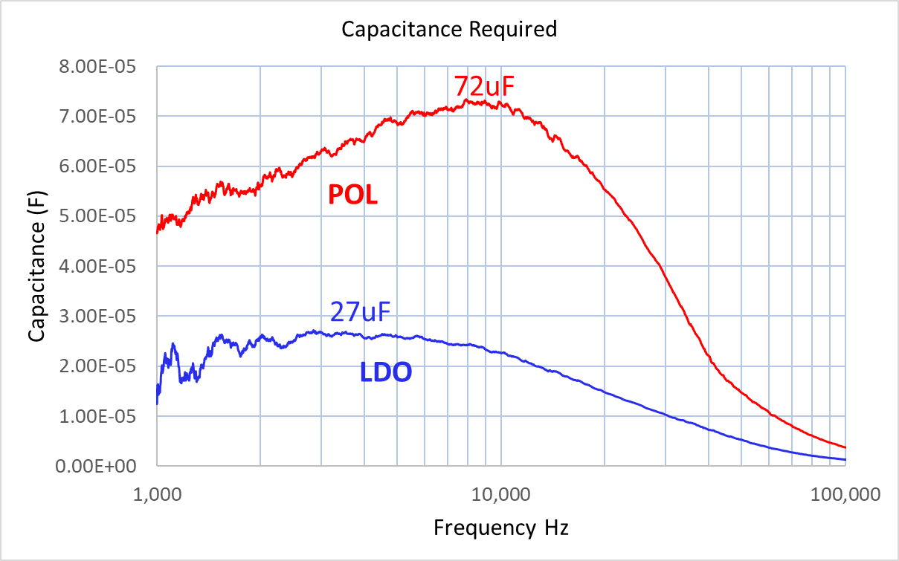

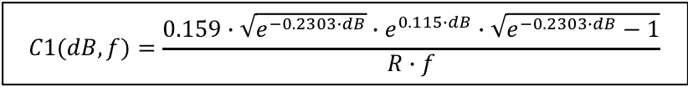

Simplest Noise Filter
$$R1=\frac{100mV}{Idc}=\frac{100mV}{39mA}=2.6OΩ$$
Tolerating a larger voltage drop results in a smaller capacitor.
The voltage setpoint can be increased if this is the only load on the regulator
$$C1(dB,f)=\frac{0.159∙\sqrt{e^{−0.2303∙dB}}∙e^{0.115∙dB}∙\sqrt{e^{−0.2303∙dB}−1}}{R∙f}$$
$$ESRmax=\frac{0.707∙R}{e^{−0.115∙dBmax}−1}$$
Notes:
The simplest filter is a single pole R-C type filter, and that is generally sufficient for low power applications. This clock draws 38mA at 3.3V, represented by an 87 Ω load resistor. The clock power supply spec is 3.3V + 10% and we’ll use 3% of the 10% budget for power supply filter. This leaves room for the tolerance of the power supply and the operating clock current while still complying with the -10% minimum voltage. The resistor value is calculated from the 3% value or 100mV and the 38mA operating clock current. In this example a 2.6 Ω resistor is inserted between the voltage regulator and the clock. With the resistor value fixed, the capacitance required at each frequency can be calculated based on the attenuation required.
I also calculated the capacitance requirements for the LDO in blue and the switching regulator in RED. Choosing the maximum capacitance from each of the curves, 27uF is required for the linear regulator and 72uF is required for the switching regulator. The maximum
ESR is also calculated for each power supply. Its actually better to keep the ESR towards the high side, first because it is cheaper and second because we want to avoid possible resonance of any ceramic capacitors inside the oscillator and the ESL of the filter capacitor.

Slide 29
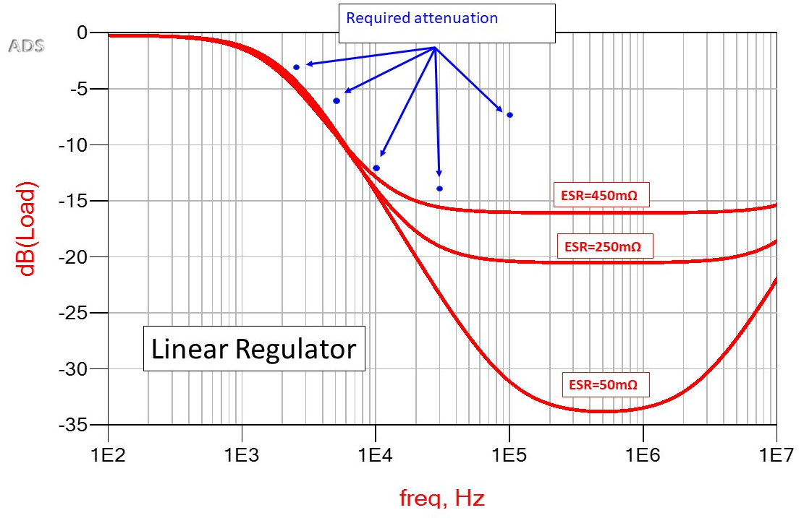
Linear Regulator Noise Filter
Here is the filter attenuation for the LDO regulator using the 27uF capacitor with various ESR.
The required attenuation is also shown at various frequencies for comparison.
Ideally a 450mOhm ESR 27uF capacitor would be selected.
Preferably keep the ESR towards the higher side of the limit to avoid potential resonances with capacitors internal to the sensitive circuit.
Notes:
Here is the filter attenuation for the LDO regulator using the 27uF capacitor with carious ESR. The required attenuation is also shown for comparison. So ideally a 450mOhm ESR 27uF capacitor would be selected

Slide 30
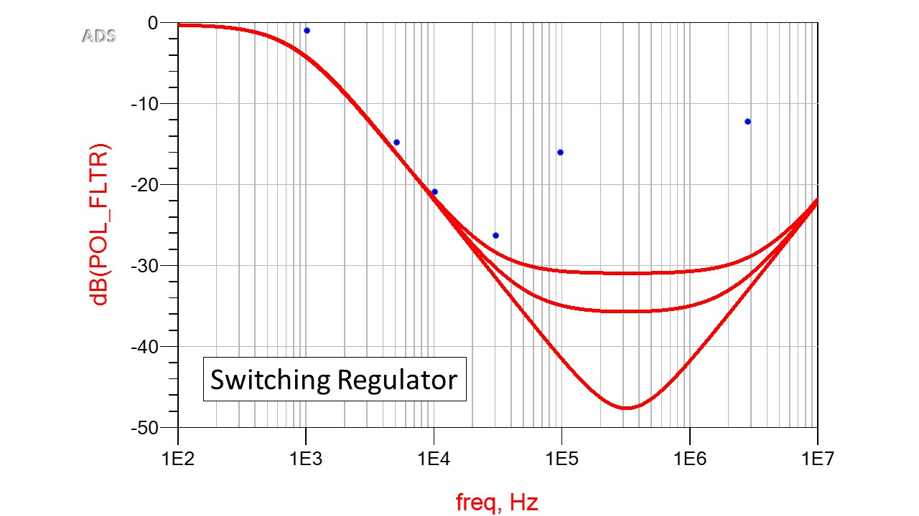
Switching Regulator Noise Filter
A similar simulation for the switching regulator filter shows the performance of the calculated capacitor along with the required attenuation.
For the switching regulator a 30mOhm 75uF capacitor would work well.
Of course the next larger standard value can also be used.
Again, it is generally best to use capacitors towards this high side of the limit to avoid resonances with internal capacitors
Required attenuation
Notes:
And a similar simulation for the switching requlator shows the performance of the calculated capacitor along with the required attenuation. For the switching regulator a 30mOhm 75uF capacitor would work well. Of course the next larger standard value can also be used

Slide 31
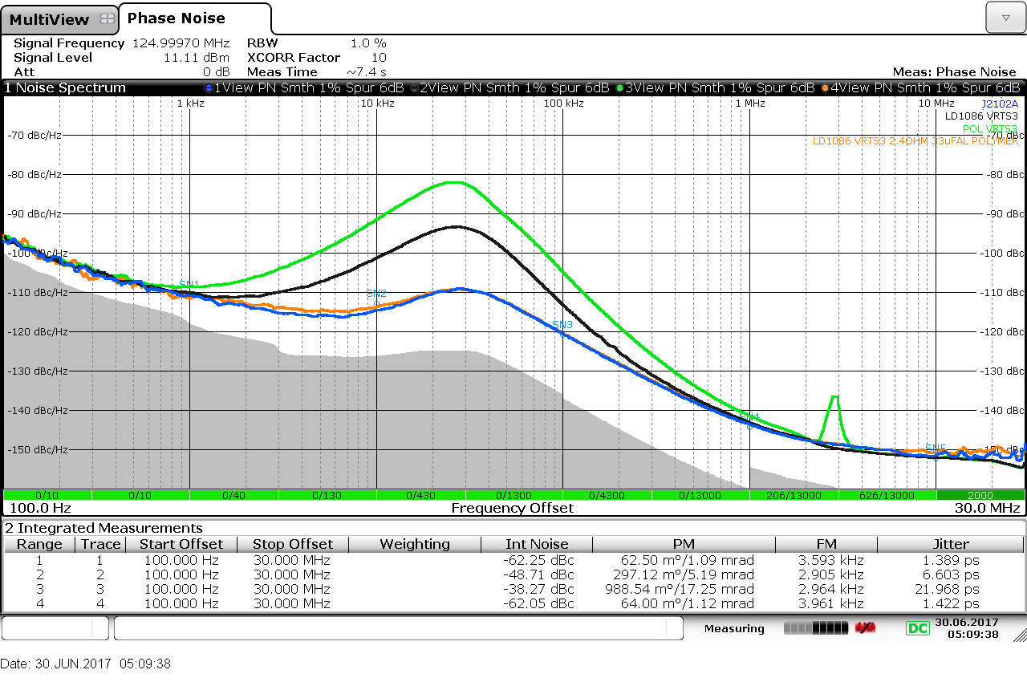
Putting the Process to the Test
The VRTS3 demo board includes a 2.49 Ohm resistor that can be switched in between the linear regulator and the clock.
A 33uF, aluminum electrolytic was added and a 4th trace is added to our previous measurements in orange.
The trace with the filter is nearly identical to the noise free measurement.
The filtered jitter is within 2% of the 1.39ps noise free measurement, while the linear regulator alone was 6.6ps and the switching regulator was 22ps.
-81dB
-93dB
-110dB
-110dB
Fsw
-120dB
Notes:
Let’s put it to the test. The VRTS3 demo board includes a 2.49 Ohm resistor that can be switched in between the linear regulator and the clock making it simple to insert the linear regulator filter. The demo board also includes a capacitor that can be switched in across the 3.3V power supply near the clock. I replaced this capacitor with a 33uF, 30mΩ ESR aluminum type and switched it in to add a 4th trace to our previous measurements. The new trace with the filter is shown here in orange, and is nearly identical to the noise free measurement, as promised. Looking at the jitter, you can see the noise free measurement was 1.39ps and the filtered linear regulator is within a about 2% at 1.42ps. for comparison, the unfiltered linear regulator jitter was 6.6ps and the switching regulator 22ps.

Slide 32
How much noise is allowed.
We know the noise each power supply presents
And we know how much we need to reduce it by
14dB
25dB
25kHz
Just Add Them!
Notes:
The power supply noise density can be determined by adding the voltage regulator noise density and the noise gain required. If you can export the noise density measurement to EXCEL that makes it significantly easier to generate the curve.

Slide 33
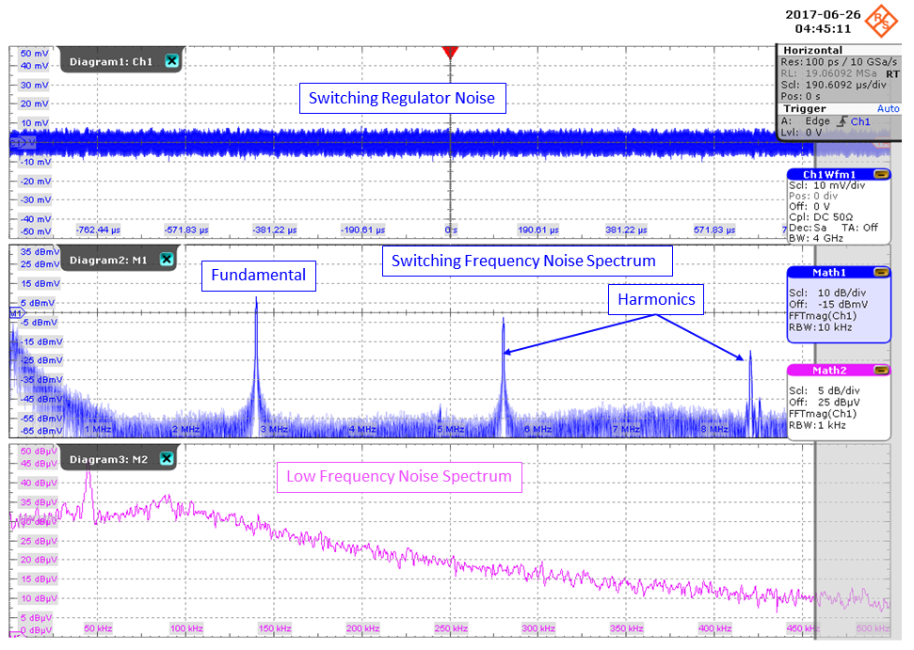
Unexpected Noise – 2.8MHz POL
The 2.8MHz switching regulator generates noise at the switching frequency and its harmonics as expected
We don’t see spurious responses below 2.8MHz and yet we can see noise in the low frequency to 100kHz band.
We also saw the clock performance was much worse at 30kHz than the linear regulator.
WHY?
1kHz RBW
Notes:
The 2.8MHz switching regulator generates noise at the switching frequency and its harmonics as expected. We don’t see spurious responses below 2.8MHz though we can see broadband noise up to about 100kHz.
We also saw the clock performance was much worse at 30kHz than the linear regulator. So where did the low frequency noise come from

Slide 34
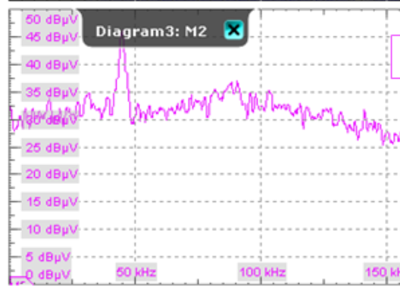
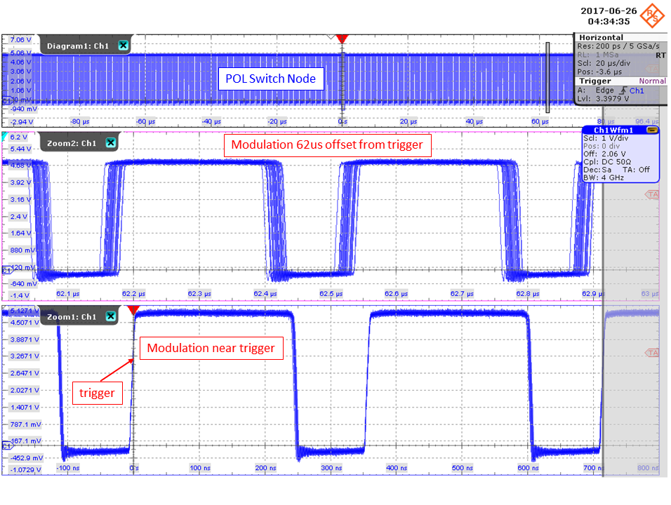
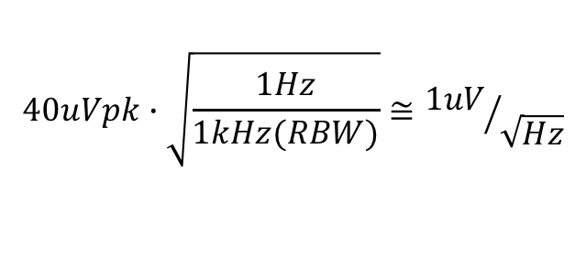

Why The Low Frequency Noise?
This is in very good agreement with the signal source analyzer noise density measurement
1kHz RBW
$$32dBuV=40uVpk$$
$$40uVpk∙\sqrt{\frac{1Hz}{1kHz(RBW)}}≅{1uV}/{\sqrt{Hz}}$$
Notes:
We tend to look at switching waveforms close to the trigger, where it looks clean. Looking at 62us after the trigger notice that both switching edges are modulated, so the oiwer supply itself is generating low frequency noise from modulation. The 32dBuV noise level seen on the oscilloscope with a 1kHz bandwidth can be converted to the 1Hz bandwidth used in the noise density measurement. This 1uV is in agreement with the noise density seen on the phase noise analyzer and the oscilloscope noise density measurement. This modulation may be intentional to reduce EMI or it could just be switching frequency jitter. The datasheet doesn’t mention spread spectrum for EMI, and since this is a feature it is often highlighted. In this application it degrades the oscillator performance. Also beware of switching regulators that have pulse skipping or burst mode operation. When operating at light loads these modes improve efficiency, but they generate a lot of low frequency noise that can be very difficult to filter.

Slide 35

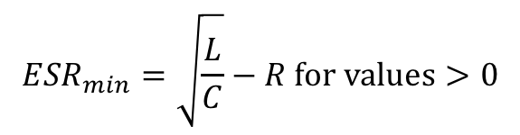
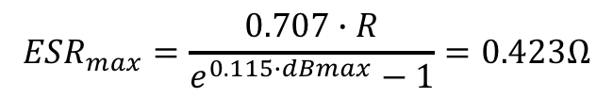
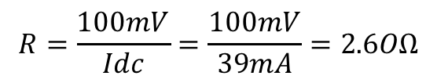
About Ferrite Beads
$$L_{max}=C∙R^{2}$$
$$R=\frac{100mV}{Idc}=\frac{100mV}{39mA}=2.6OΩ$$
If R approaches zero
then NO INDUCTANCE ALLOWED
$${ESR}_{max}=\frac{0.707∙R}{e^{0.115∙dBmax}−1}=0.423Ω$$
$${ESR}_{min}=\sqrt{\frac{L}{C}}−R for values>0$$
Notes:
There isn’t generally a benefit from using a ferrite bead to isolate the noise from the clock. At low frequencies, a ferrite bead is a high Q inductor and still requires a reduce to obtain low Q. If the series resistance isn’t large enough, the remainder can be included as capacitor ESR. A negative value for ESRmin just indicates that ESR is not required for damping.

Slide 36
0.3, 1.3 and 2.3Ohm resistance
Without sufficient damping a resonant peak exists.
Phase noise will be evident at the frequency of the peak.
In most cases there is no benefit to adding a series inductor. If there is be sure to provide adequate damping.
Without the resistance
Significant peaking will occur
Notes:
Adding a series inductor increase the high frequency attenuation, though this isn’t usually necessary. The resistor is still needed to reduce the resonant Q of the inductor and capacitor. Without the resistor the peaking in the response will be apparent in the phase noise.

Slide 37


An parallel inductor solution is usually larger and much more costly than the resistor alone
Parallel damping is less effective than series damping, but reduces the DC voltage drop
$$L=4∙C∙R^{2}$$
$$L=4∙27uF∙{2.6Ω}^{2}=720uH$$

Slide 38
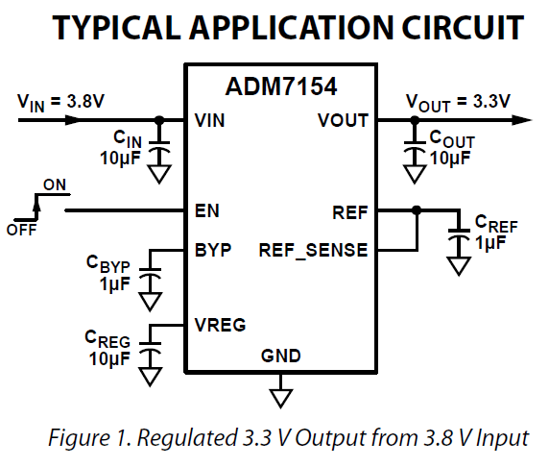
“RF” Ultra-Low-Noise Options
Ultra-low noise voltage regulators are available from several manufacturers.
These regulators are typically much more expensive than typical voltage regulators and require a large number of capacitors to provide low noise performance.
In most cases the simple R-C will be a much more cost effective solution.
A special regulator like this may be helpful if the circuit is sensitive to very low frequency noise, but this isn’t often the case.
Notes:
Special ultra-low noise voltage regulators are available from several manufacturers. These regulators are typically much more expensive than typical voltage regulators and require a large number of capacitors to provide low noise performance. In most cases t he simple R-C will be a much more cost effective solution. A special regulator like this may be helpful if the circuit is sensitive to very low frequency noise, but this isn’t often the case.

Slide 39
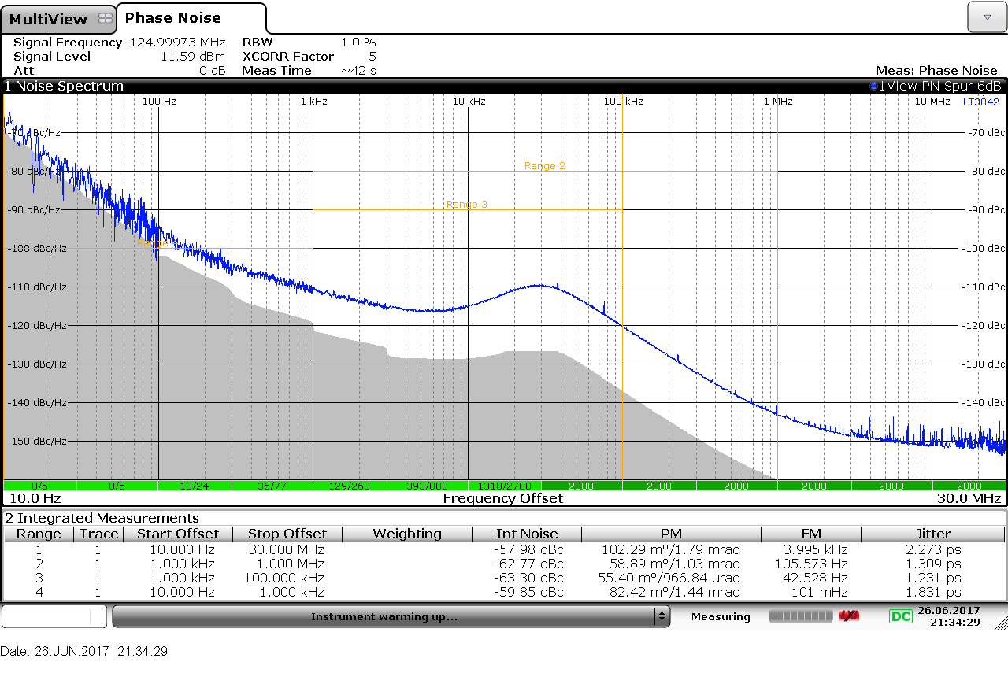
Powered by LT3042 Ultra-Low Noise Regulator
This is the clock phase noise powered by a LT3042 ultra-low noise voltage regulator.
The jitter integration ranges are slightly different than prior measurements
The frequencies show the performance is identical to the filtered performance.
This voltage regulator is a perfectly acceptable solution, though with much higher parts count and cost.
-110dB
-110dB
-120dB
Notes:
Here is a measurement of the clock powered by the LT3042 ultra low noise power supply. The jitter integration ranges are slightly different than prior measurements but comparison at the frequencies show the performance is identical to the filtered performance. This voltage regulator is a perfectly acceptable solution, though with much higher parts count and cost.

Slide 40
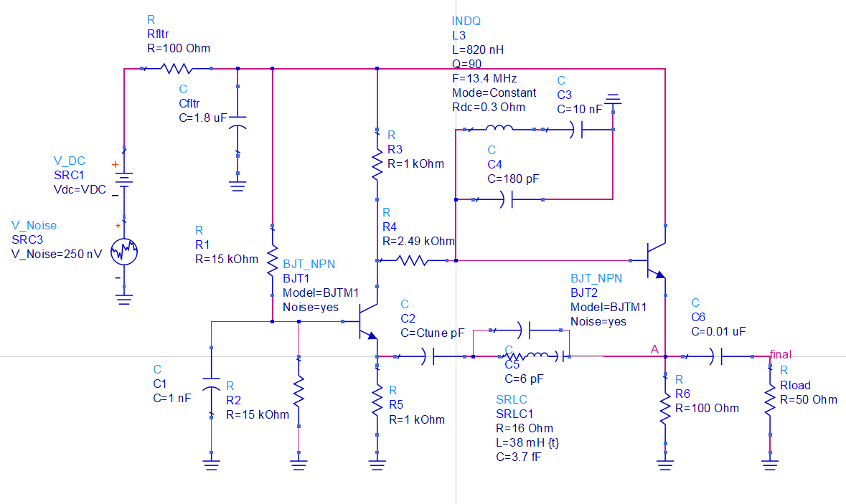
Simulated Phase Noise
Phase noise without power supply noise
Phase noise with power supply noise
Phase noise with power supply noise and filter
Notes:
In some cases the phase noise can be simulated together with the power supply in order to evaluate the noise sensitivity

Slide 41
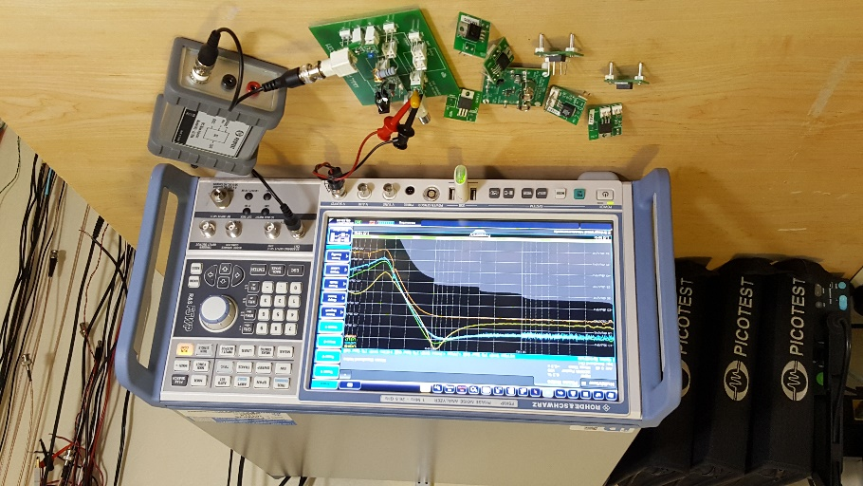
Not all regulators are created equal
Measure LOTS of them!
Notes:
Voltage regulators are all different, especially when it comes to noise characteristics. We measure a lot of them before finally selecting one. Here you can see a characterization board with plugh in daughter cards to make the process quick and efficient.

Slide 42
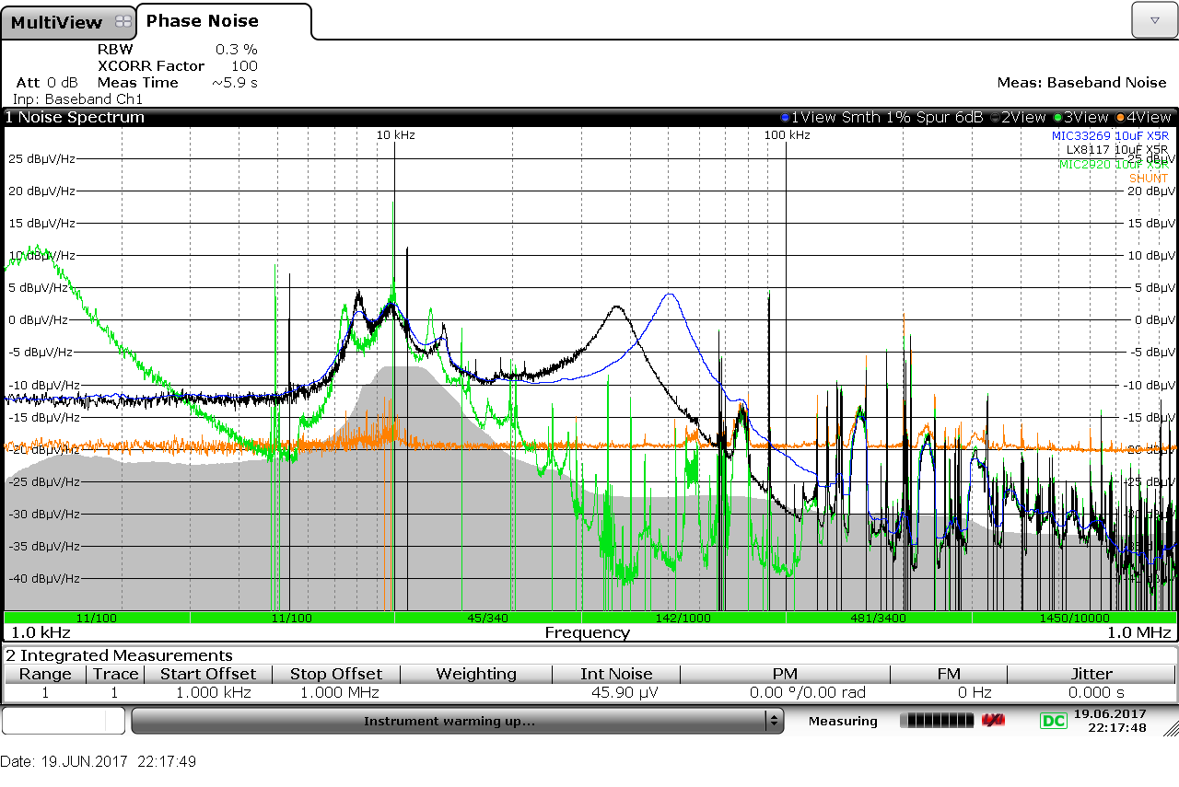
Noise Density of Several Linear Regulators
Here are just a few of the regulators we’ve measured.
Interestingly we can see one (green) has low frequency spurs.
Others have many larger peaks. These peaks are often stability related. Larger, higher ESR output capacitors can help with stability
The orange graph from a shunt regulator, can be a good choice for sensitive circuits if the circuit operating current is static.
Notes:
Here are just a few of the regulators we’ve measured.
Interestingly we can see one (green) has low frequency spurs.
Others have many larger peaks. These peaks are often stability related. Larger, higher ESR output capacitors can help with stability
The orange graph from a shunt regulator, can be a good choice for sensitive circuits if the circuit operating current is static.

Slide 43
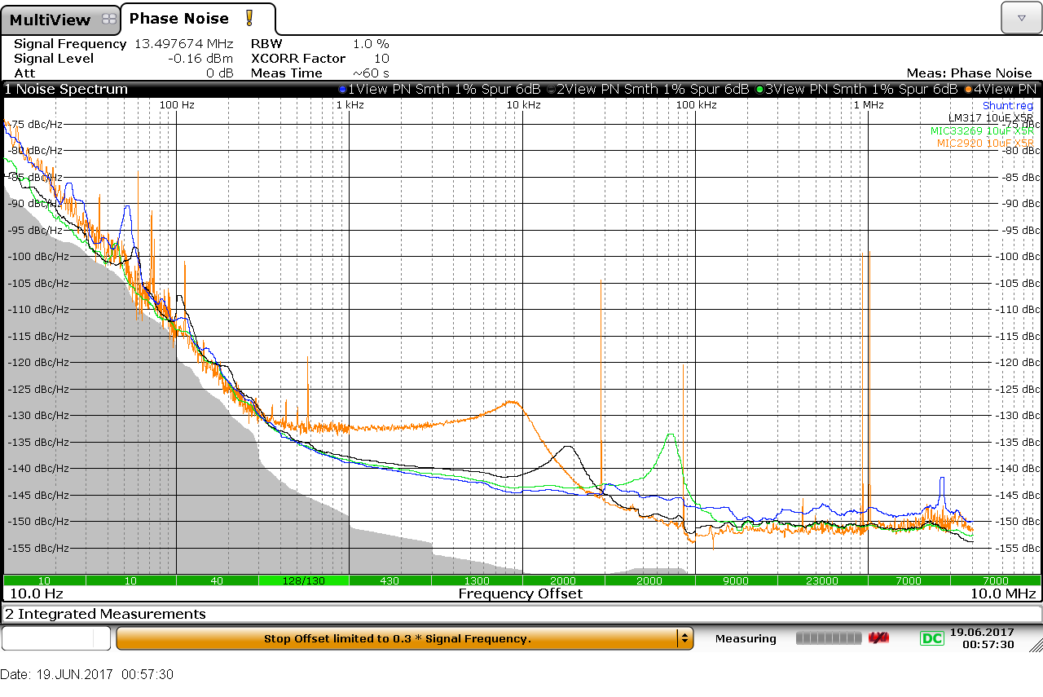
Associated Phase Noise
Here are the phase noise lots that go along with these regulators.
The blue trace is the best behaved, and this is with the shunt regulator.
Note the noise peaks appear as phase noise here
Notes:
Here are the phase noise lots that go along with these regulators. The blue trace is the best behaved, and this is with the shunt regulator. Note the noise peaks appear as phase noise here

Slide 44
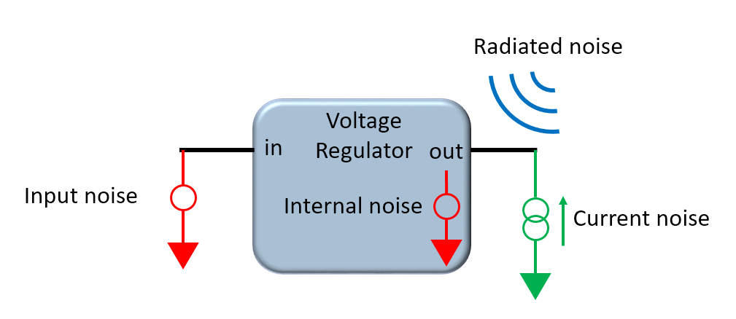
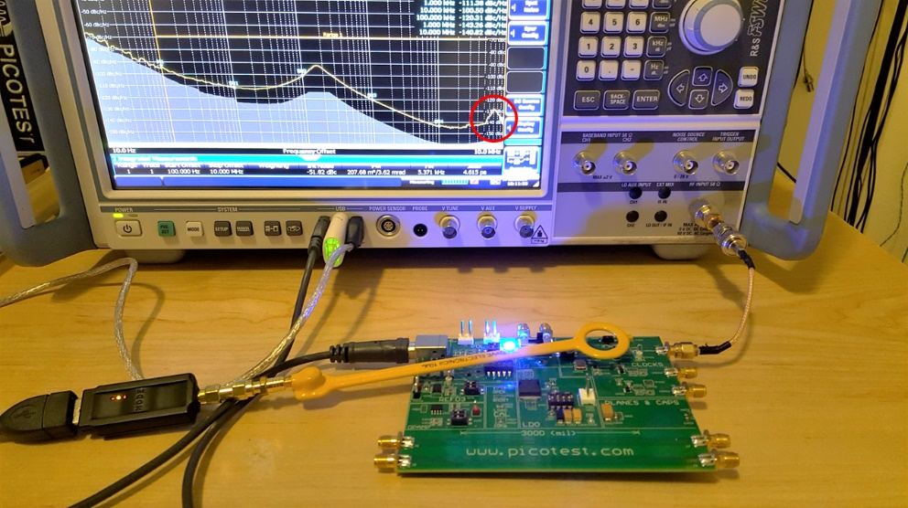
Consider all the ways noise gets in
Watch the coaxial cables and power interconnects also
Notes:
There are many paths that noise can take to get to the load circuit and each requires consideration. Higher PSRR voltage regulators can help, keep sensitive circuits as far from noise sources as practical. Noise can be generated by other loads sharing the power supply input or output.

Slide 45
Conclusion and Links
www.picotest.com/blog
http://www.analog.com/en/technical-articles/power-supplies-high-speed-adc.html

Slide 46
Thank You For Attending this Webinar
This webinar was organized by Signal Integrity Journal and will be archived at :
https://www.signalintegrityjournal.com/events/range/archive
Thank you to Rohde & Schwarz for Sponsoring this Webcast. Please visit them online.

