Slide 1
Closely Connected: Power Integrity and Signal Integrity
Steven M. Sandler - Picotest
Rohde & Schwarz Electronic Design and Test Day
Munich Germany
Feb 21, 2019

Slide 2

SI
PI
This Photo by Unknown Author is licensed under CC BY-NC
Notes:
The relationship between SI and PI is quite complex. SI results in power rail noise and power rail noise results in SI noise (jitter/phase-noise/transient voltage). In a perfect ecosystem, we balance the SI and PI to optimize the system design. This can often become very complex.

Slide 3
PI
SI

Slide 4
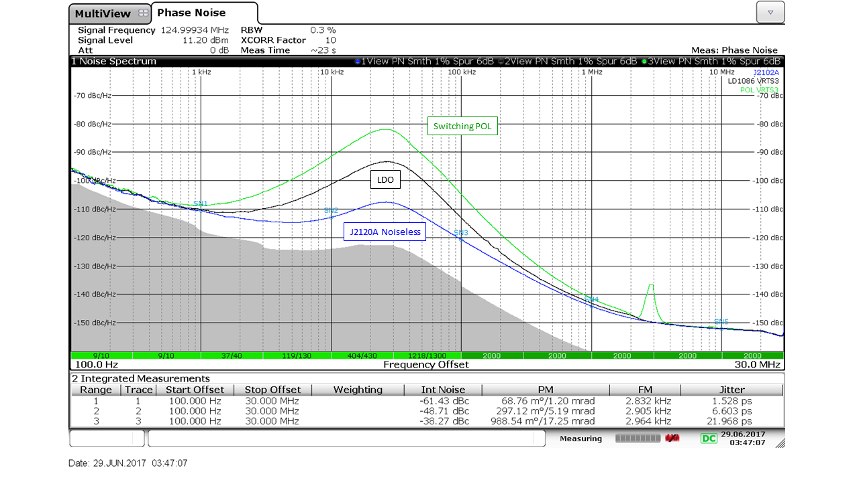
Power Supply Induced Jitter

Slide 5
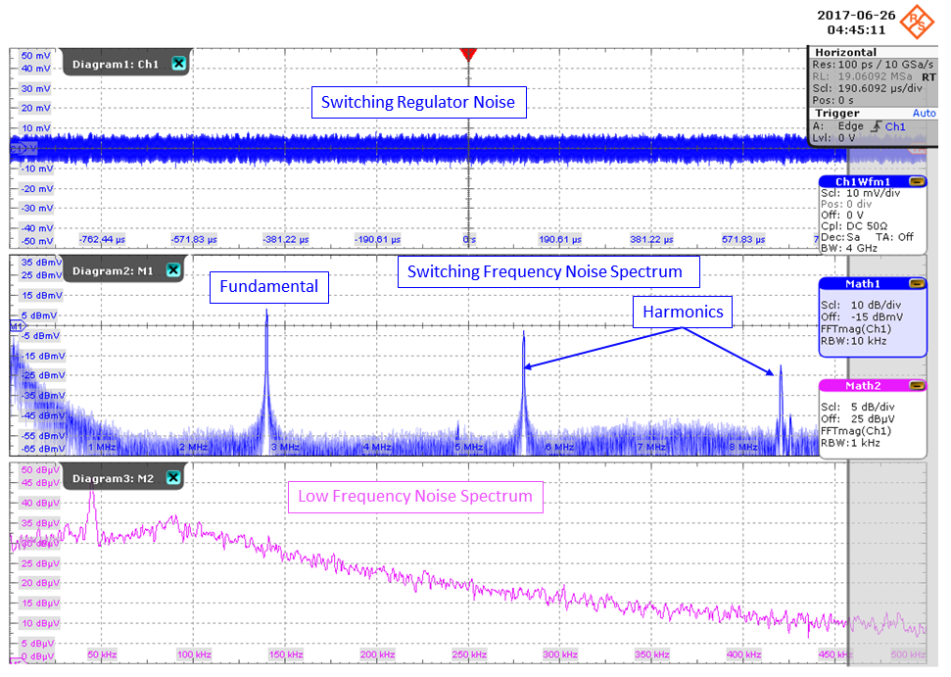
Unexpected Noise – 2.8MHz POL
1kHz RBW

Slide 6
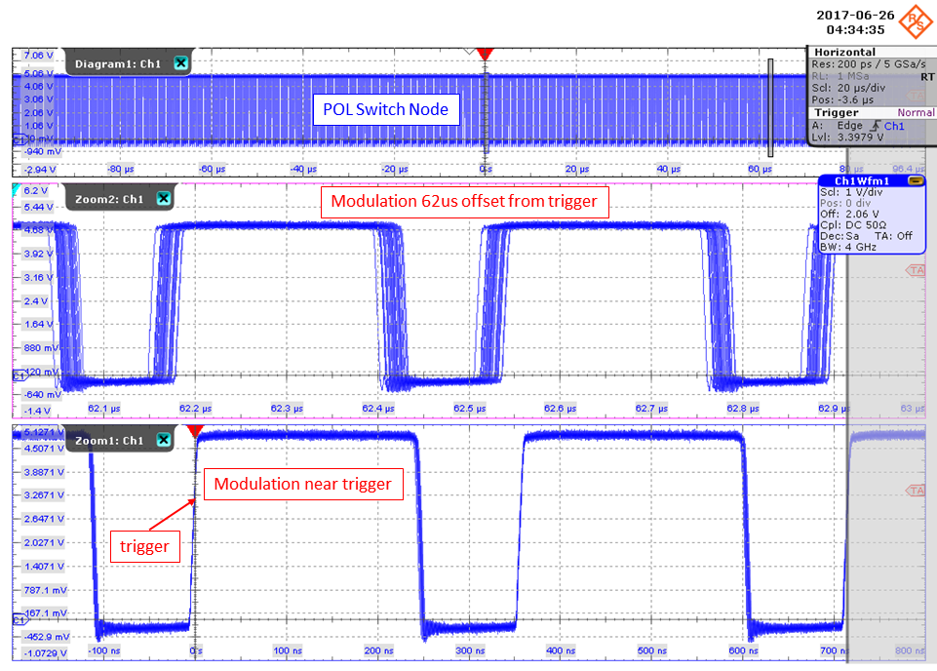
Jitter Induced Jitter

Slide 7
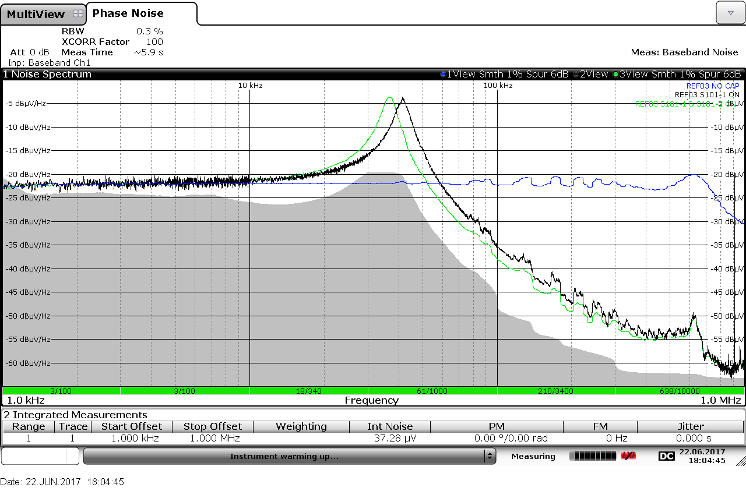
Power Supply Noise Pollutes ADC and DAC Voltage References

Slide 8
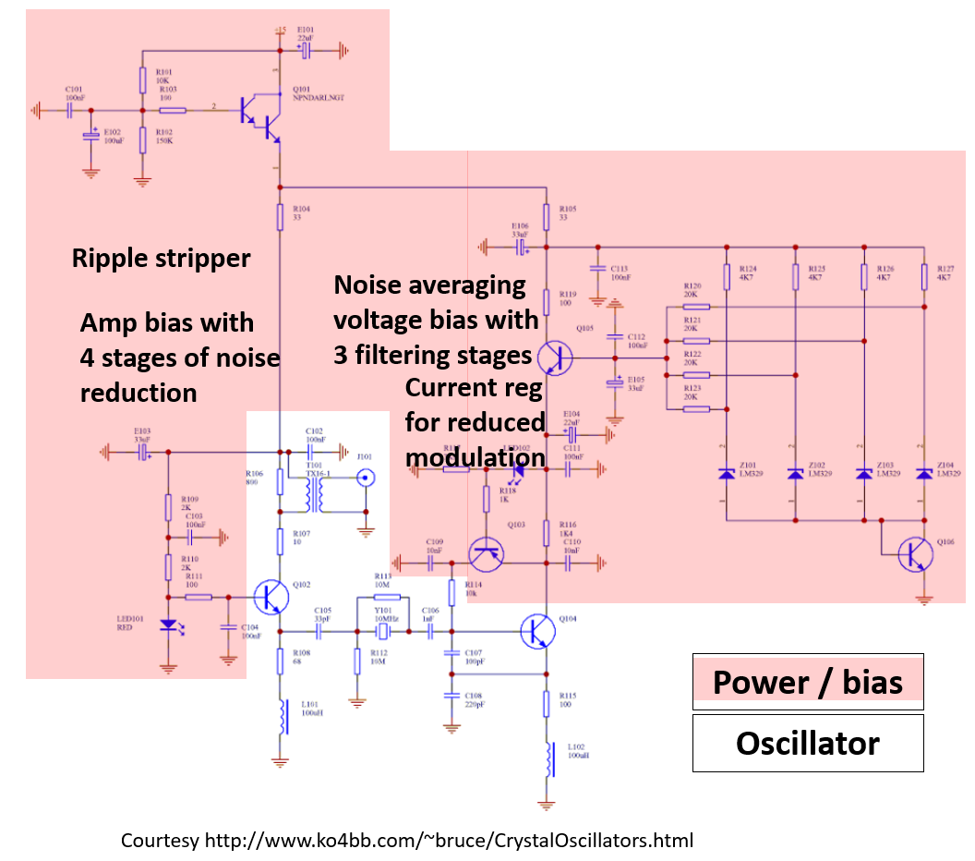
A Bit Over the Top?

Slide 9
PI
SI

Slide 10
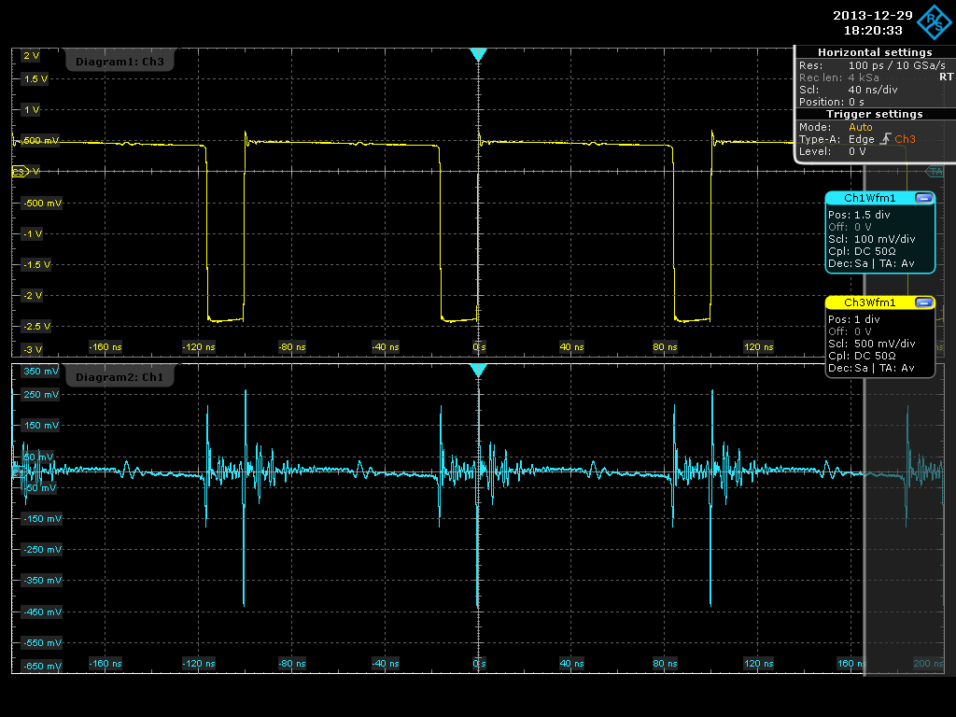
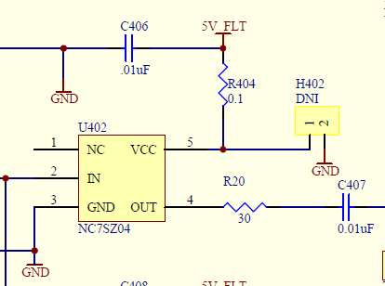
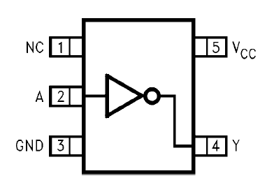
Noise Induced by a Single Logic Gate

Slide 11
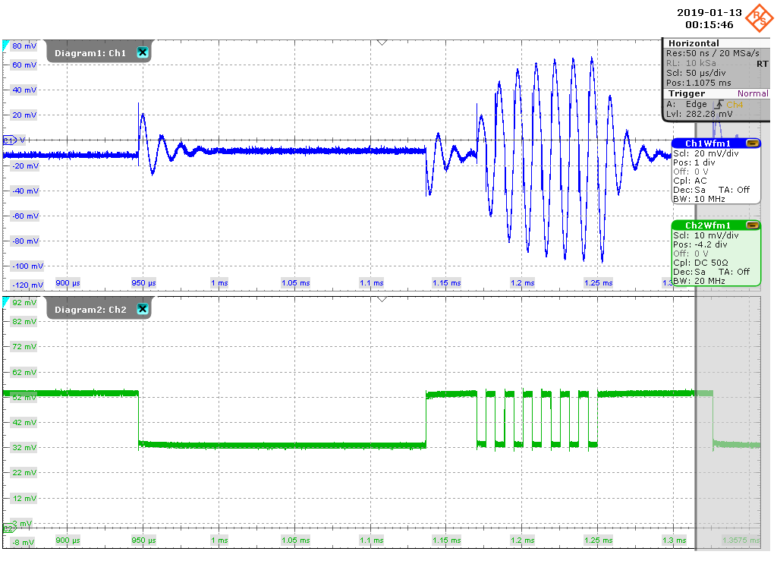
Rogue Waves

Slide 12
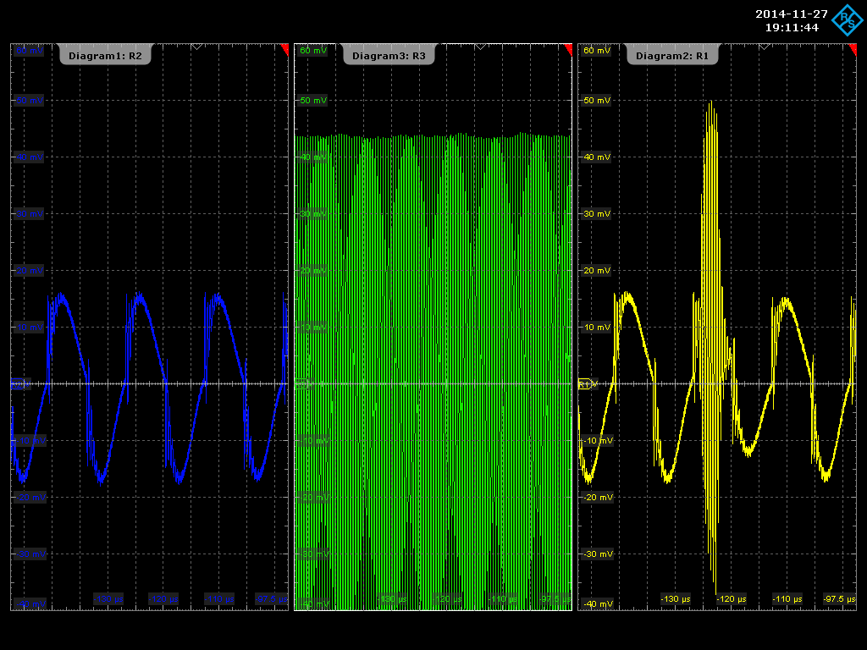
Rogue Waves

Slide 13
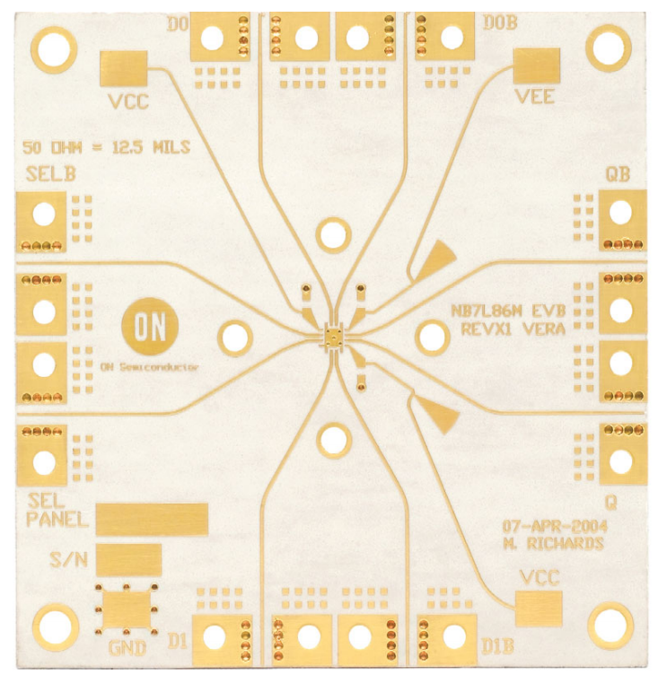
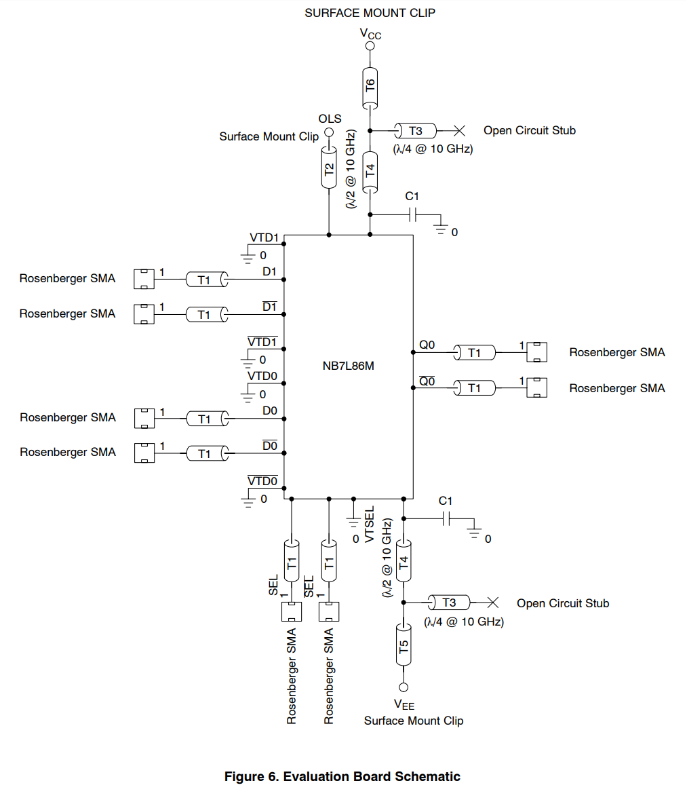
Over the Top?

Slide 14
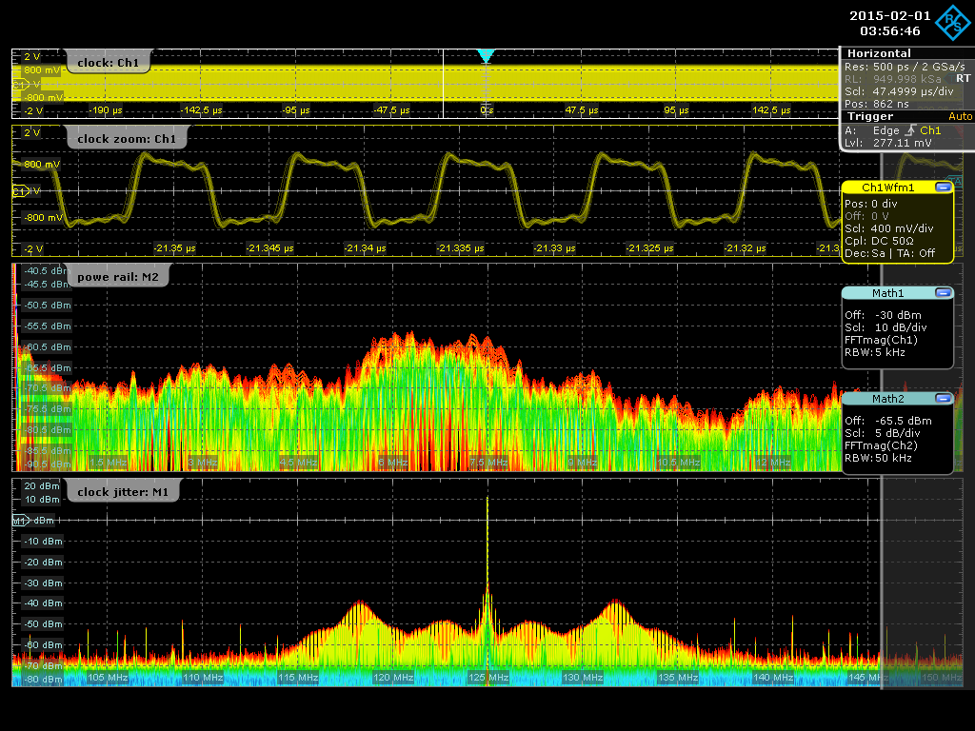
Impedance is the Common Denominator
Stability issue

Slide 15
Thank You for Attending This Presentation!
Learn more at www.picotest.com/blog
Connect with me on LinkedIn
Email me at steve@picotest.com
References
Designing Power For Sensitive Circuits, EDICON 2017 Best Paper and Signal Integrity Journal, Steve Sandler
Power Integrity for 32 Gb/s SERDES Transceivers, DesignCon 2018, Steve Sandler, Heidi Barnes, Jack Carrel

