Slide 1
Designing Power For Sensitive Circuits
Steve Sandler, Picotest
steve@picotest.com
+1-480-375-0075

Slide 2
What are sensitive circuits?
Many low power circuits are hyper-sensitive to power supply noise.
Examples of hyper-sensitive circuits include clock oscillators (XOs), low noise amplifiers (LNAs), phase locked loops (PLLs), mixers and precision voltage references to name just a few.

Slide 3
Sensitivity to power supply noise

Slide 4
Notes:
When a noise signal is presented to a non-linear circuit, individual frequencies are multiplied, resulting in mixing products. For example, the simple circuit shown in Figure 1 contains a 100 MHz signal with DC offset to bias a silicon diode. A second, 500kHz, signal is also applied to the diode. The diode is a nonlinear element with the voltage being related to the log of the diode current.

Slide 5
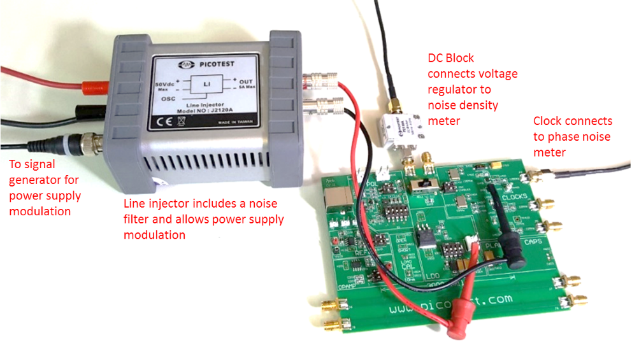
Defining Sensitivity

Slide 6
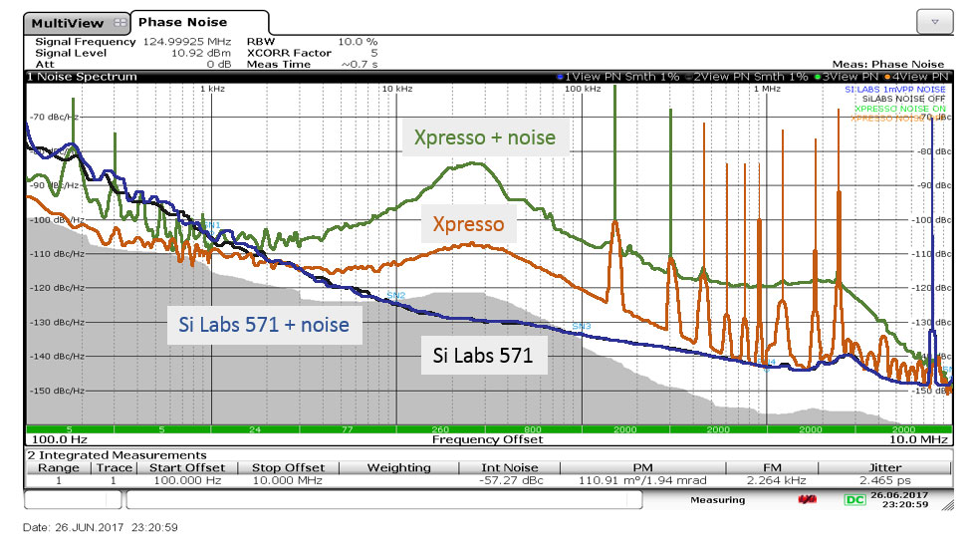
Not all sensitive circuits are sensitive

Slide 7
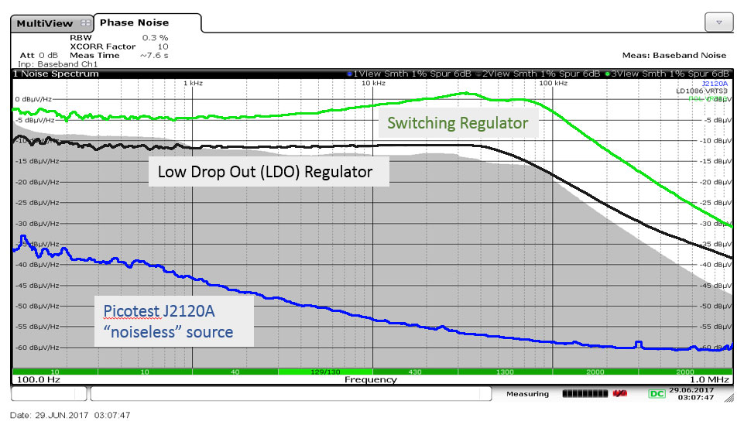
Noise Density 3 Voltage Regulators
Integrated noise voltage 1kHz to 100kHz
≈750uV_{pp}
≈100uV_{pp}
≈ 1uV_{pp}

Slide 8
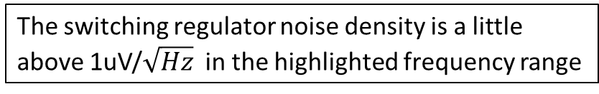
Switching Regulator Noise Density
The switching regulator noise density is a little above 1uV/$\sqrt{Hz}$ in the highlighted frequency range

Slide 9
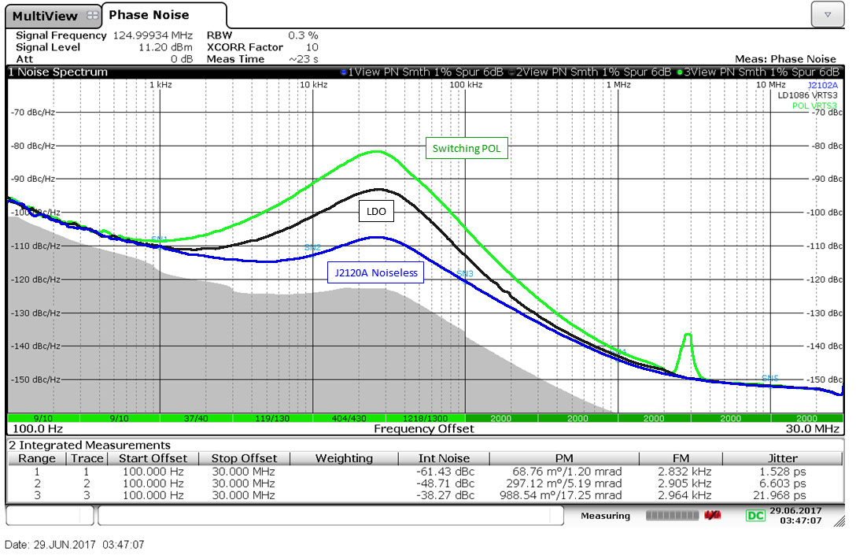
Phase Noise 3 Voltage Regulators

Slide 10
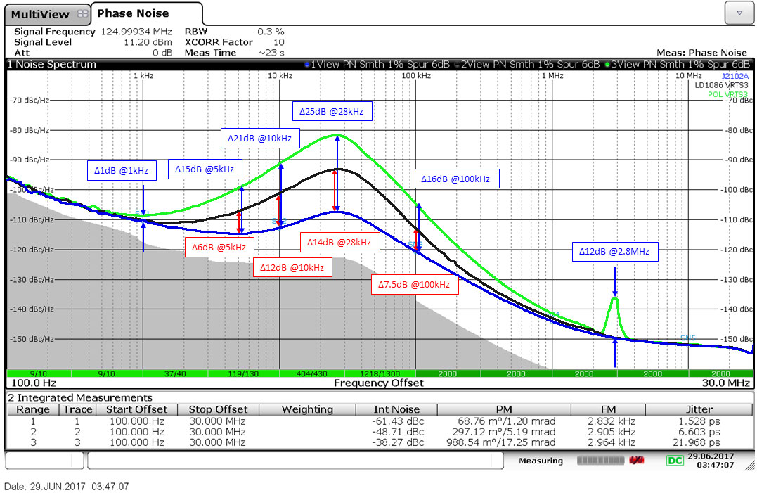
Assessing the Damage

Slide 11
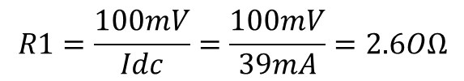
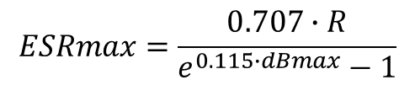
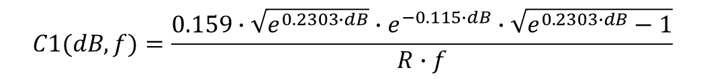
Simplest Noise Filter
Regulation and noise are not the same thing and counterintuitively they oppose each other
How much voltage can you give up?
$$R1=\frac{100mV}{Idc}=\frac{100mV}{39mA}=2.6OΩ$$
$$C1(dB,f)=\frac{0.159∙\sqrt{e^{0.2303∙dB}}∙e^{−0.115∙dB}∙\sqrt{e^{0.2303∙dB}−1}}{R∙f}$$
$$ESRmax=\frac{0.707∙R}{e^{0.115∙dBmax}−1}$$

Slide 12
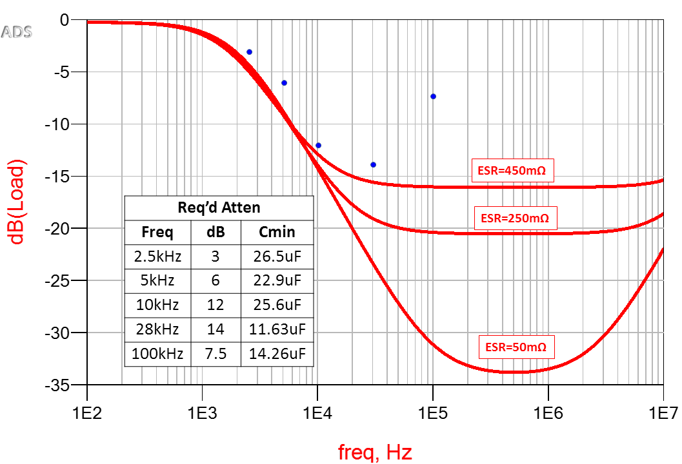
Determining the Capacitor
Required attenuation

Slide 13
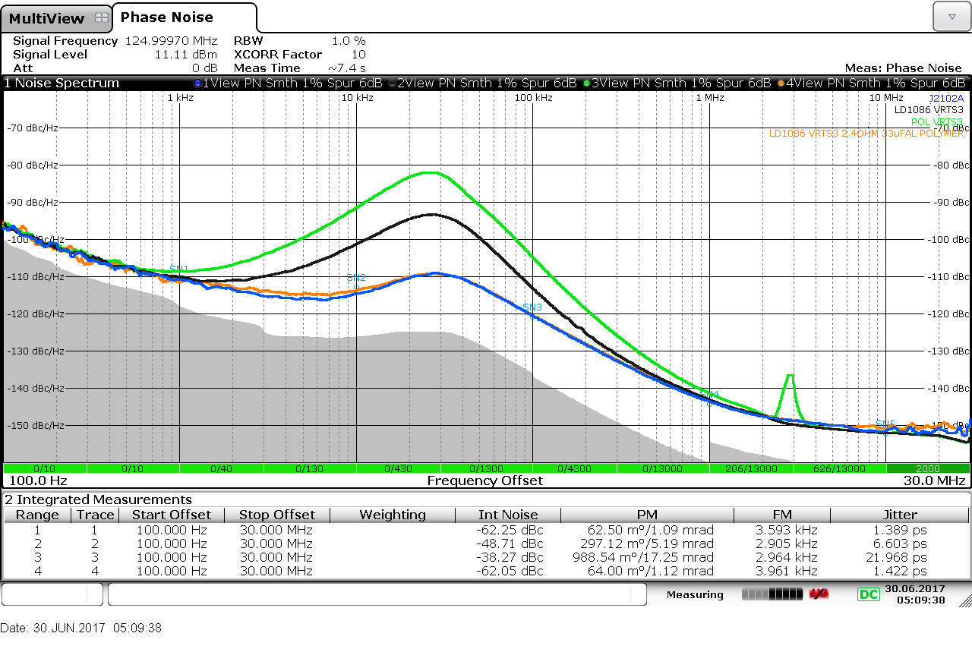
33uF/30mΩ ESR + 2.4Ω Filter

Slide 14
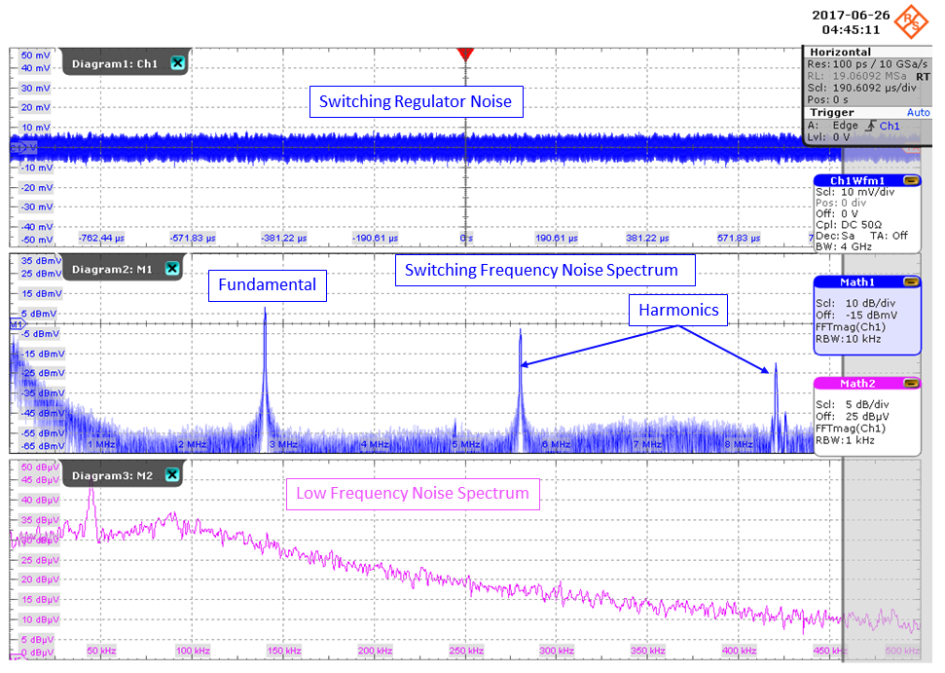
Unexpected Noise – 2.8MHz POL
1kHz RBW

Slide 15
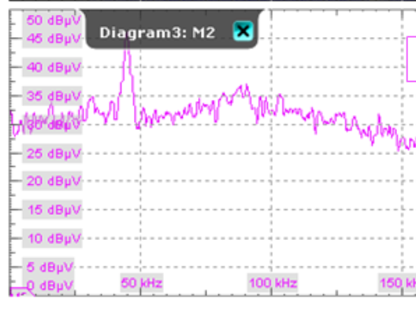
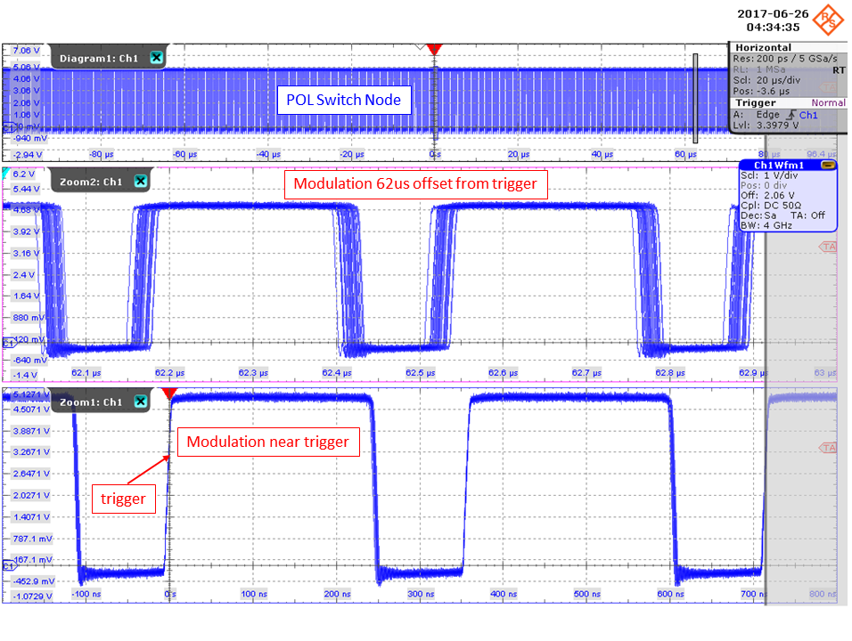
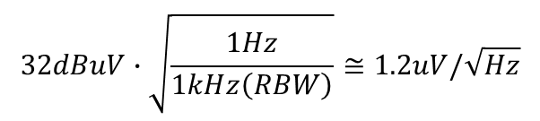

Why The Low Frequency Noise?
This is in very good agreement with the signal source analyzer noise density measurement
1kHz RBW
$32dBuV at 1kHz RBW (40uVpk$)
$$32dBuV∙\sqrt{\frac{1Hz}{1kHz\left(RBW\right)}}≅1.2uV/\sqrt{Hz}$$

Slide 16
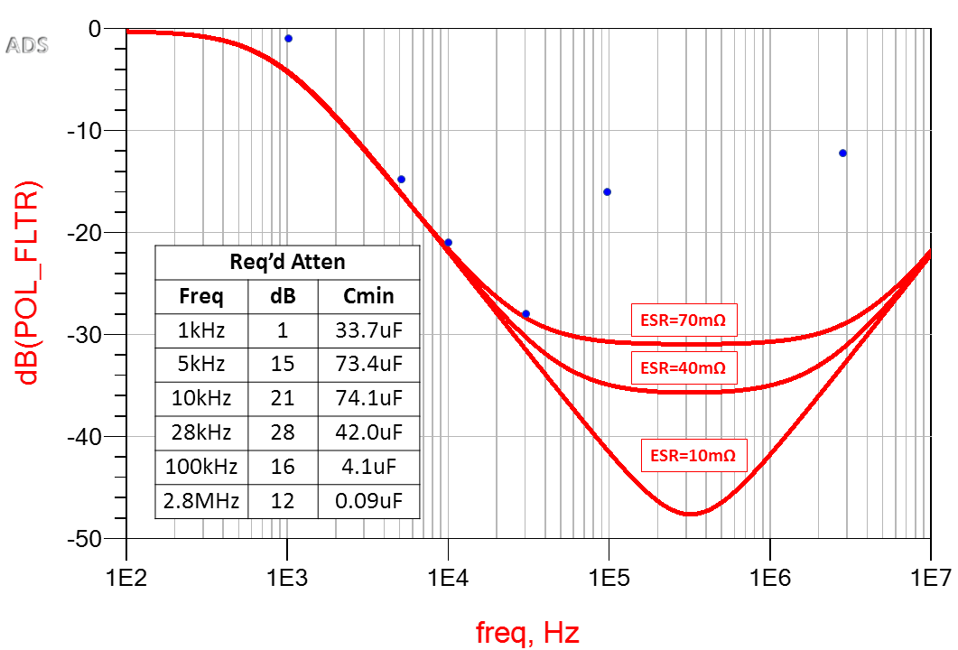
The modulation noise is accounted for
Despite the 2.8MHz switching frequency it’s the 10kHz range that defines the filter
Required attenuation

Slide 17



About Ferrite Beads
For Q=0.5
$$R=\frac{100mV}{Idc}=\frac{100mV}{39mA}=2.6OΩ$$
$$L_{max}=0.5∙C∙R^{2}$$
IF R approaches zero
then NO INDUCTANCE ALLOWED
$$ESRmax=\frac{0.707∙R}{e^{0.115∙dBmax}−1}$$

Slide 18
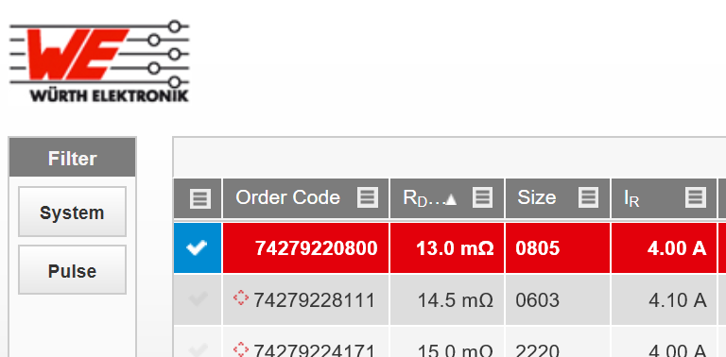
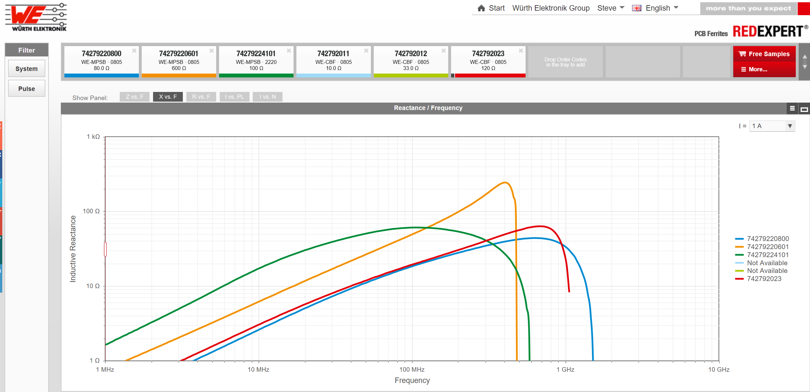

Bead datasheets generally include DCR and high frequency resistance, but look for Inductive reactance and DC Bias data or measure it yourself
Assess over the entire operating current range
$$L=\frac{X}{2π∙Frequency}$$
Courtesy of Wurth Electronik

Slide 19
0.3, 1.3 and 2.3Ohm resistance
Without the resistance
Significant peaking will occur

Slide 20
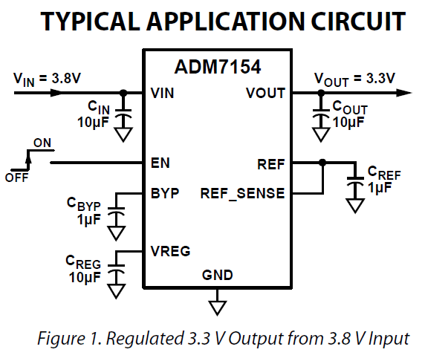
“RF” Ultra-Low-Noise Options
The precision ultra-low-noise voltage regulator offers precision in the output voltage and low noise
BUT
Count the capacitors!
Is this better or just different?
Precision voltage vs ultra-low noise

Slide 21
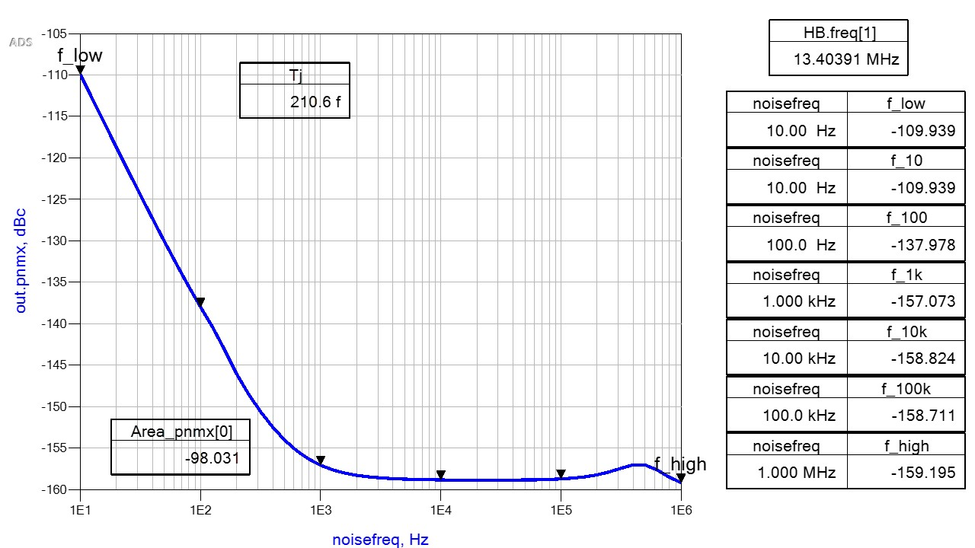
Top Tips
Low current bias also needs to be filtered.
Include phase noise and jitter in your simulations
Higher value caps are generally better than lower value caps

Slide 22
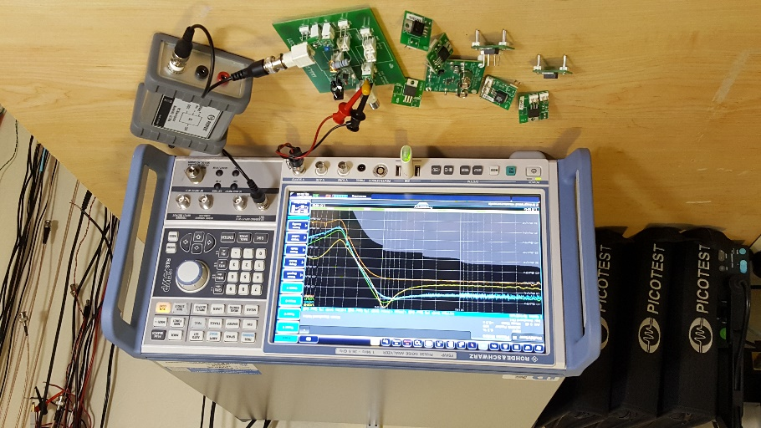
Not all regulators are created equal
Measure LOTS of them!

Slide 23
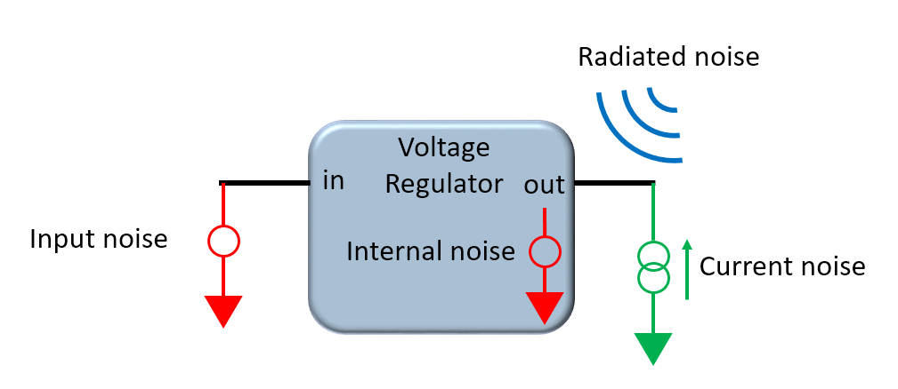
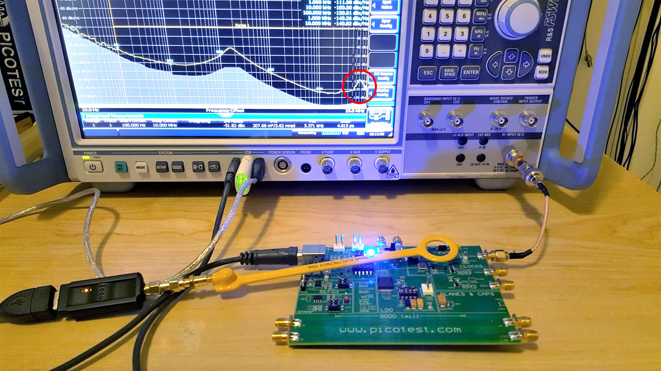
Consider all the ways noise gets in
Watch the coaxial cables and power interconnects also

Slide 24

Thanks for Attending this Session!
In this session I shared
How to determine the circuit sensitivity to power supply noise
How to choose the best voltage regulator
How to design an optimum power supply noise filter
A few of my top tips for designing power for sensitive circuits
Connect with me on LinkedIn or via email at Steve@Picotest.com
Learn more at www.picotest.com/blog

